Slide 1
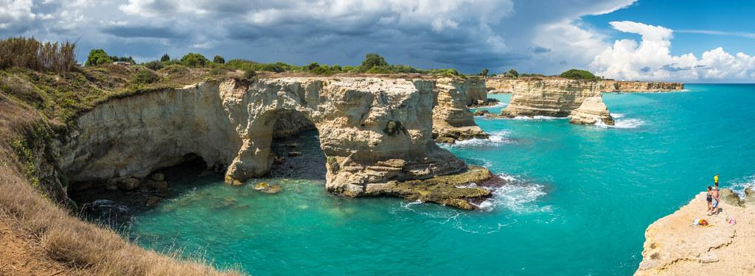
Main aspects of the Cultural Heritage of Apulia and Massafra - and the effect of the Climate change on them
Italian Team
Despotovac - Serbia 5th-10th March 2023

Slide 2
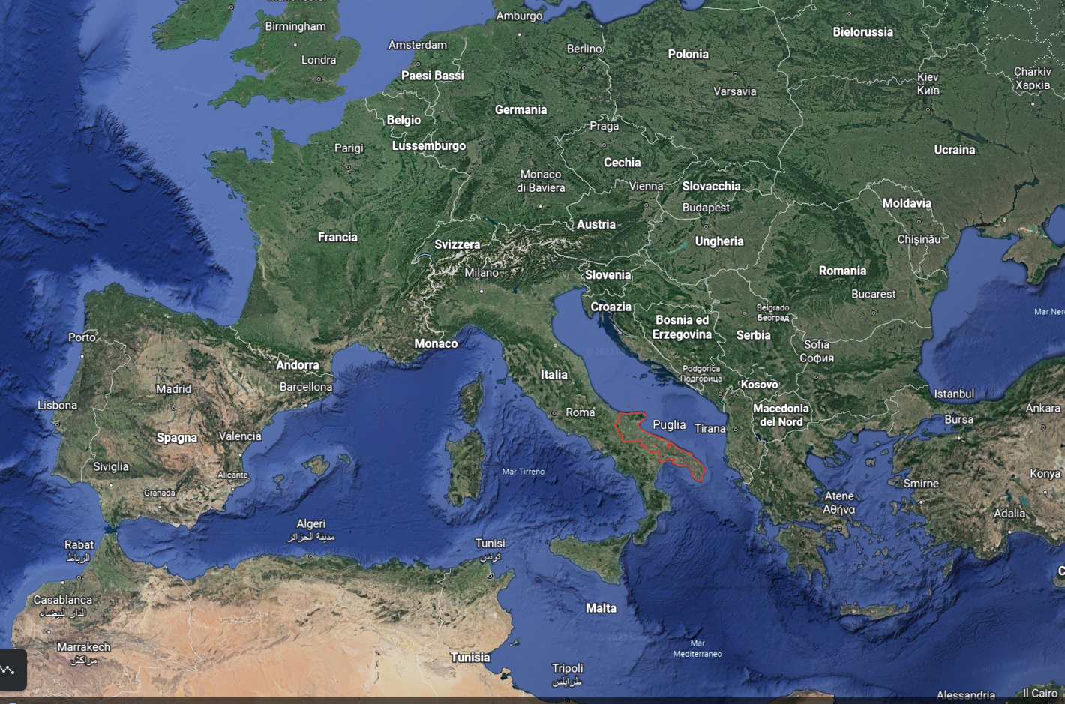
Apulia Region - Southern Italy

Slide 3
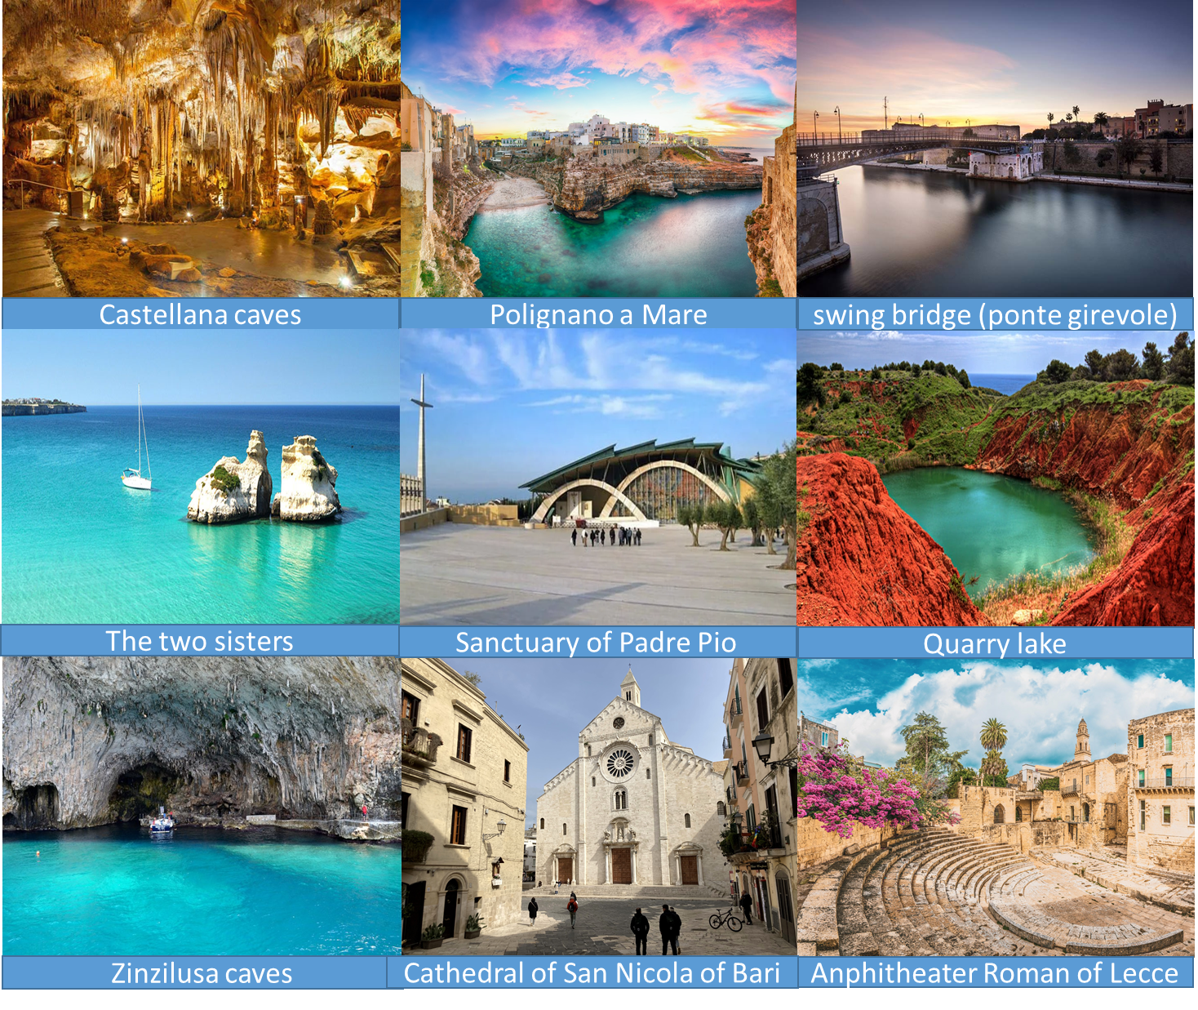
The major tourist destinations of Apulia

Slide 4
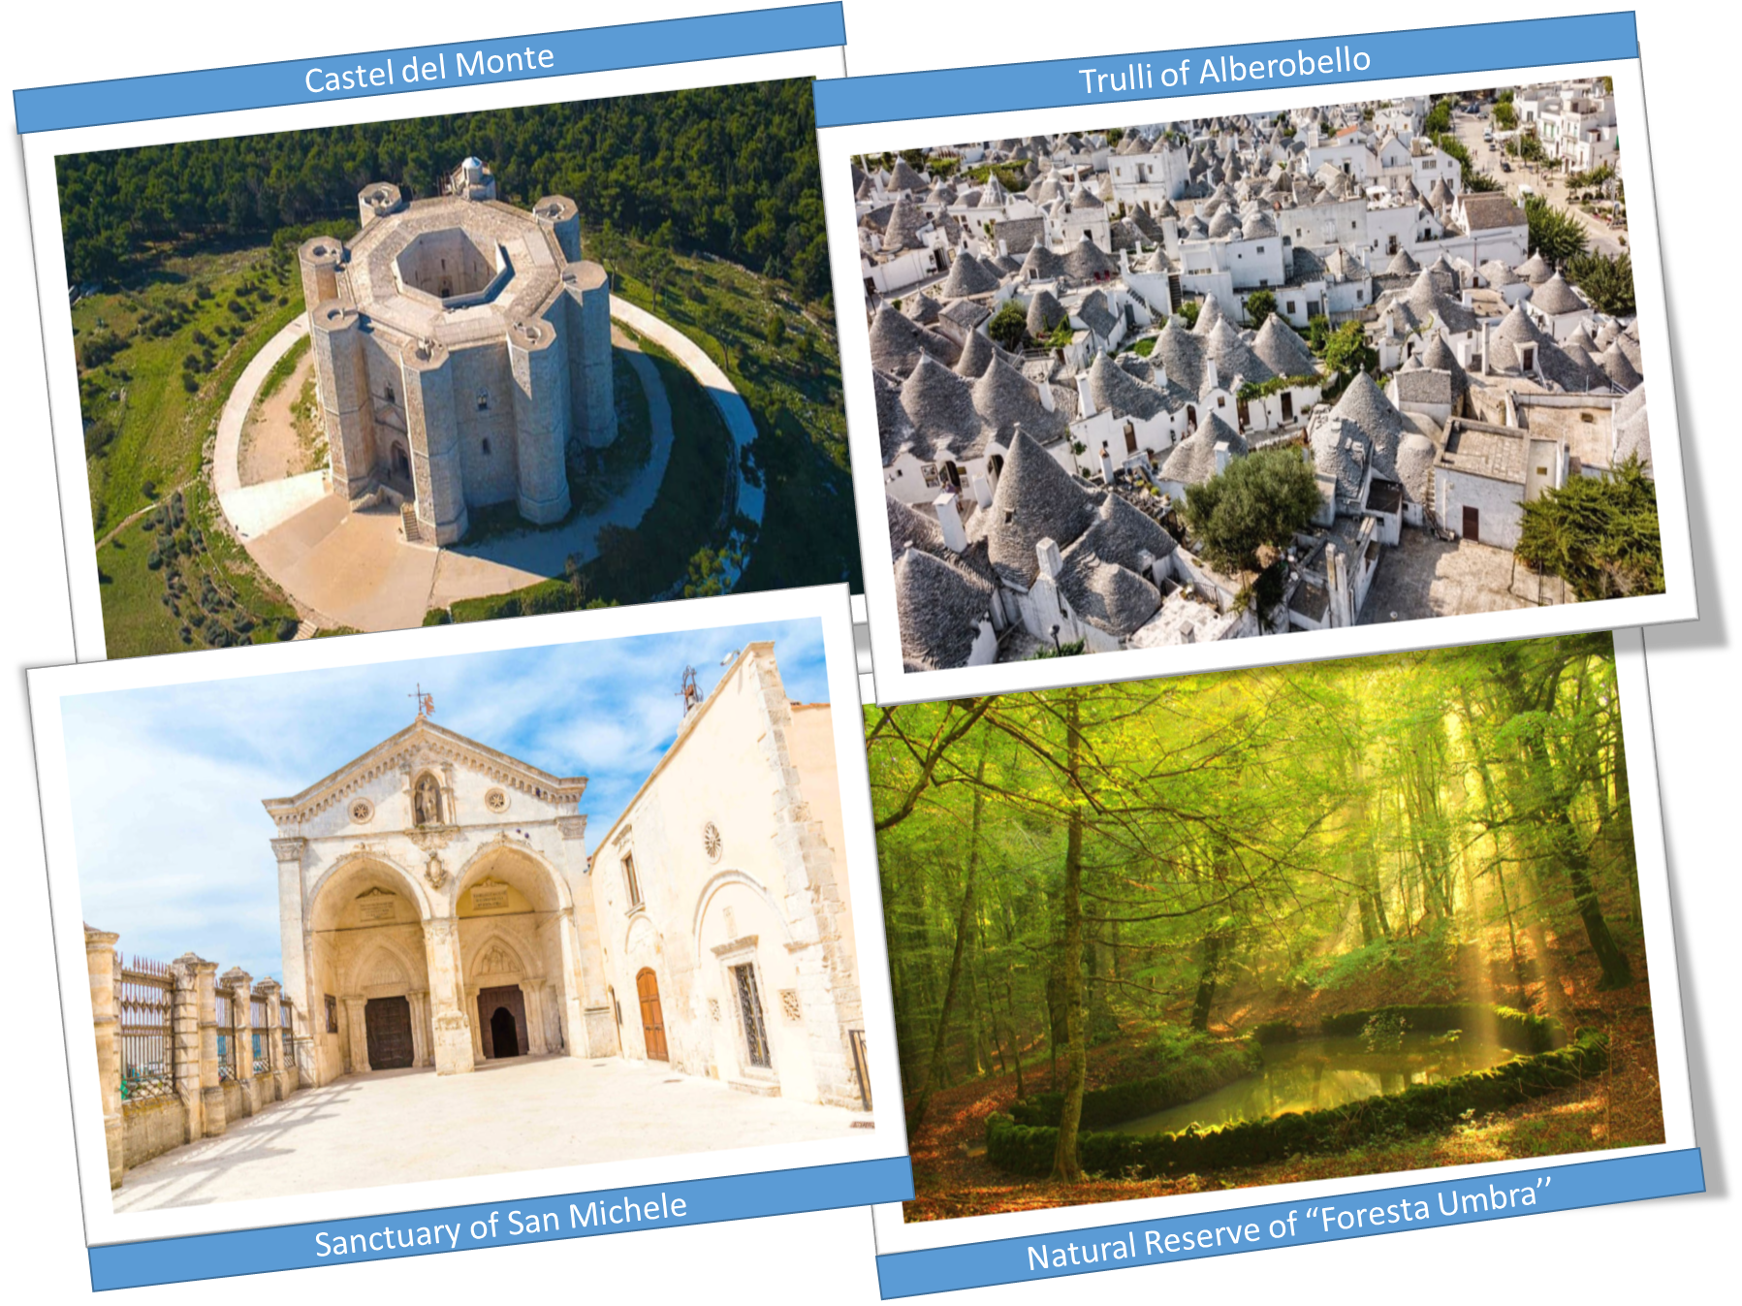
UNESCO heritage sites in Apulia

Slide 5
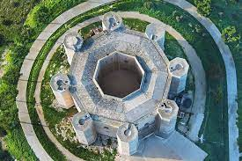
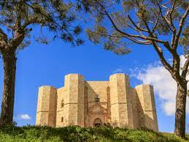
Castel del Monte
The fortress of Castel del Monte, built by the Emperor Frederick II of Swabia, is an example of medieval architecture which harmoniously blends elements of classical architecture with typical decorations of Arab architecture.
Angelica

Slide 6
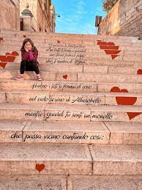
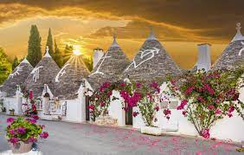
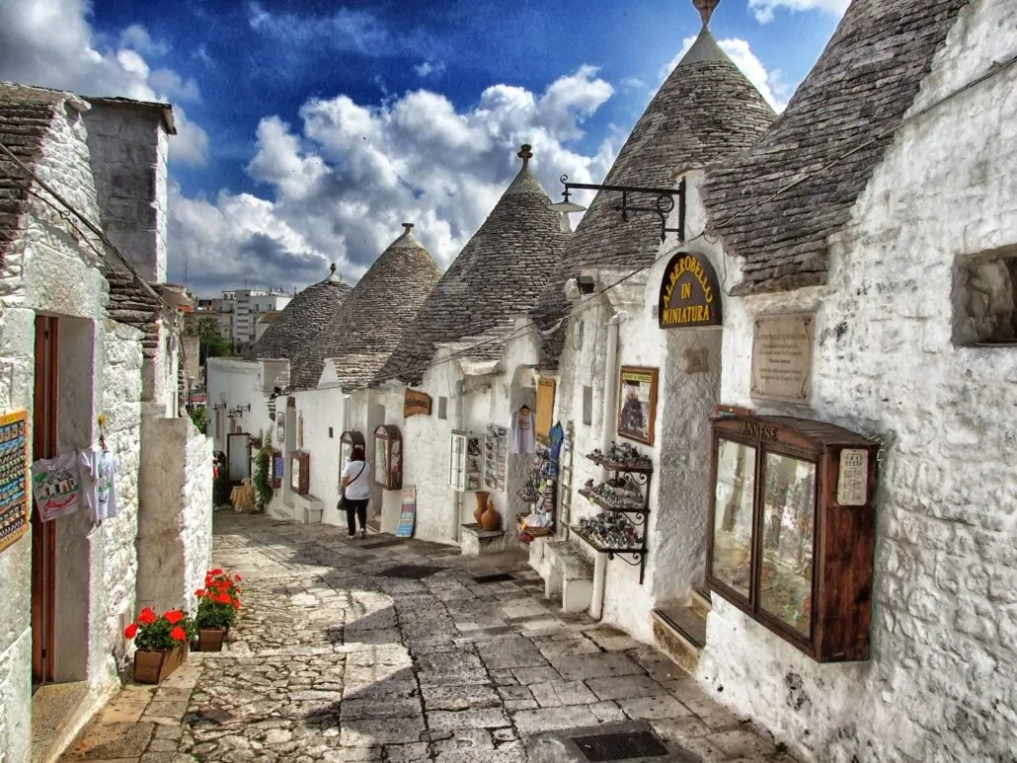
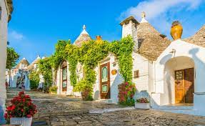
Alberobello
Alberobello is symbol of Apulia. It is known for the Trulli houses, white conical stone buildings, which populate the town and the surrounding land.

Slide 7
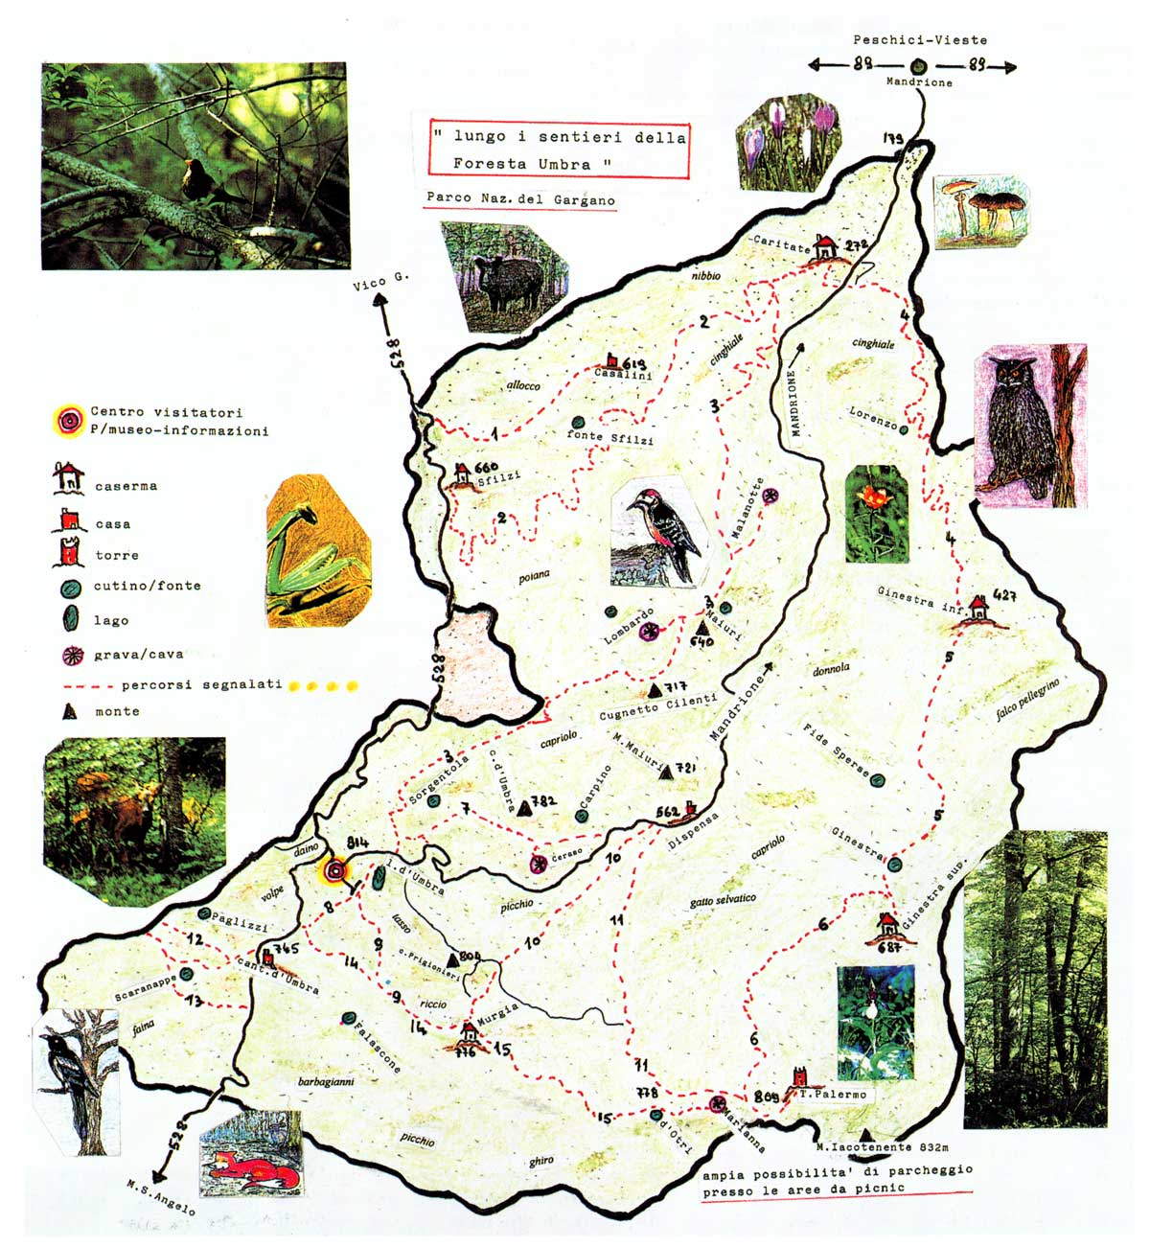
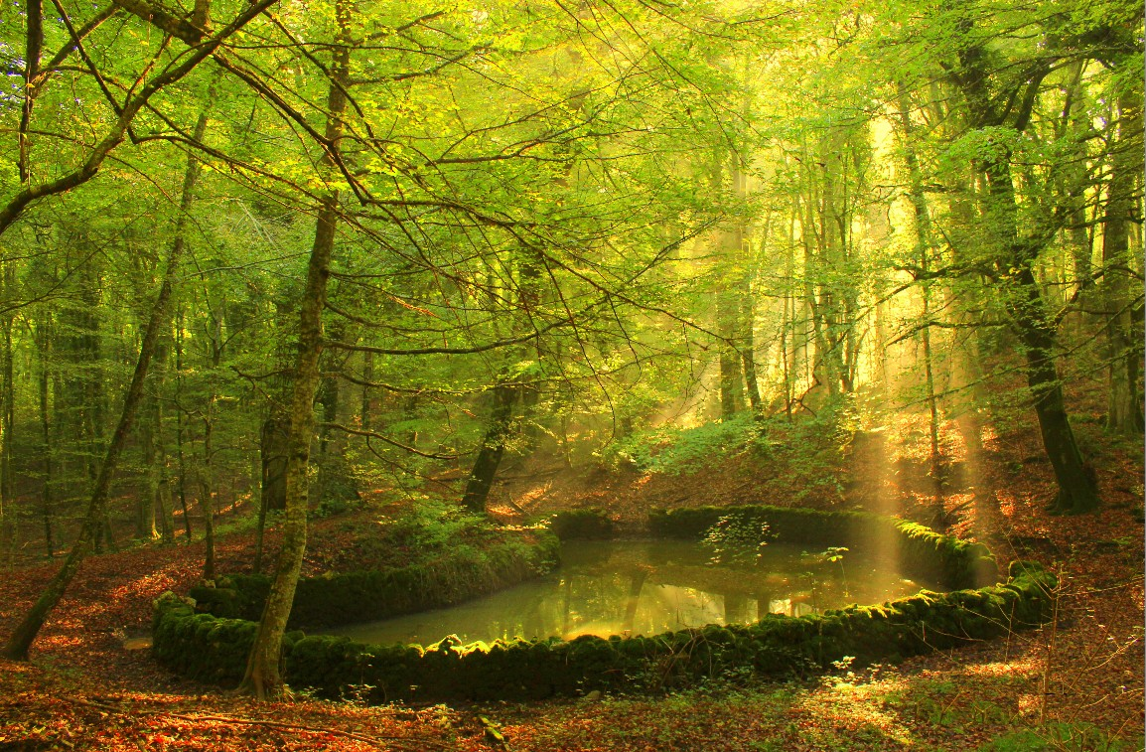
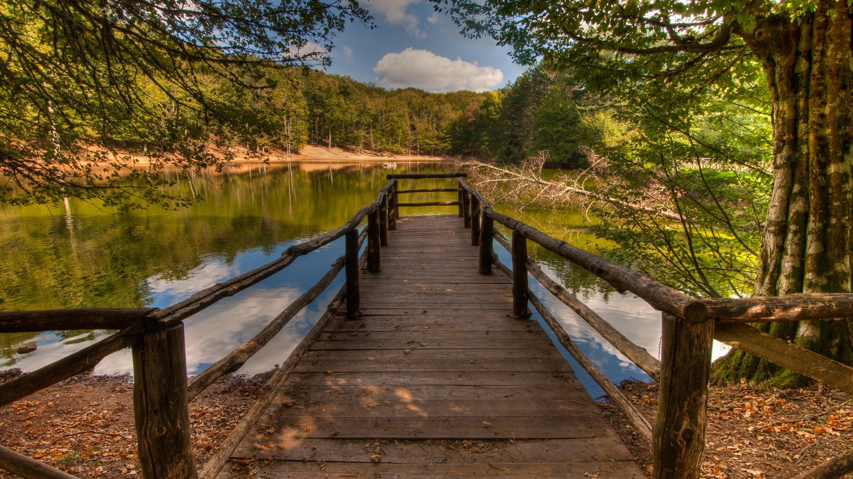
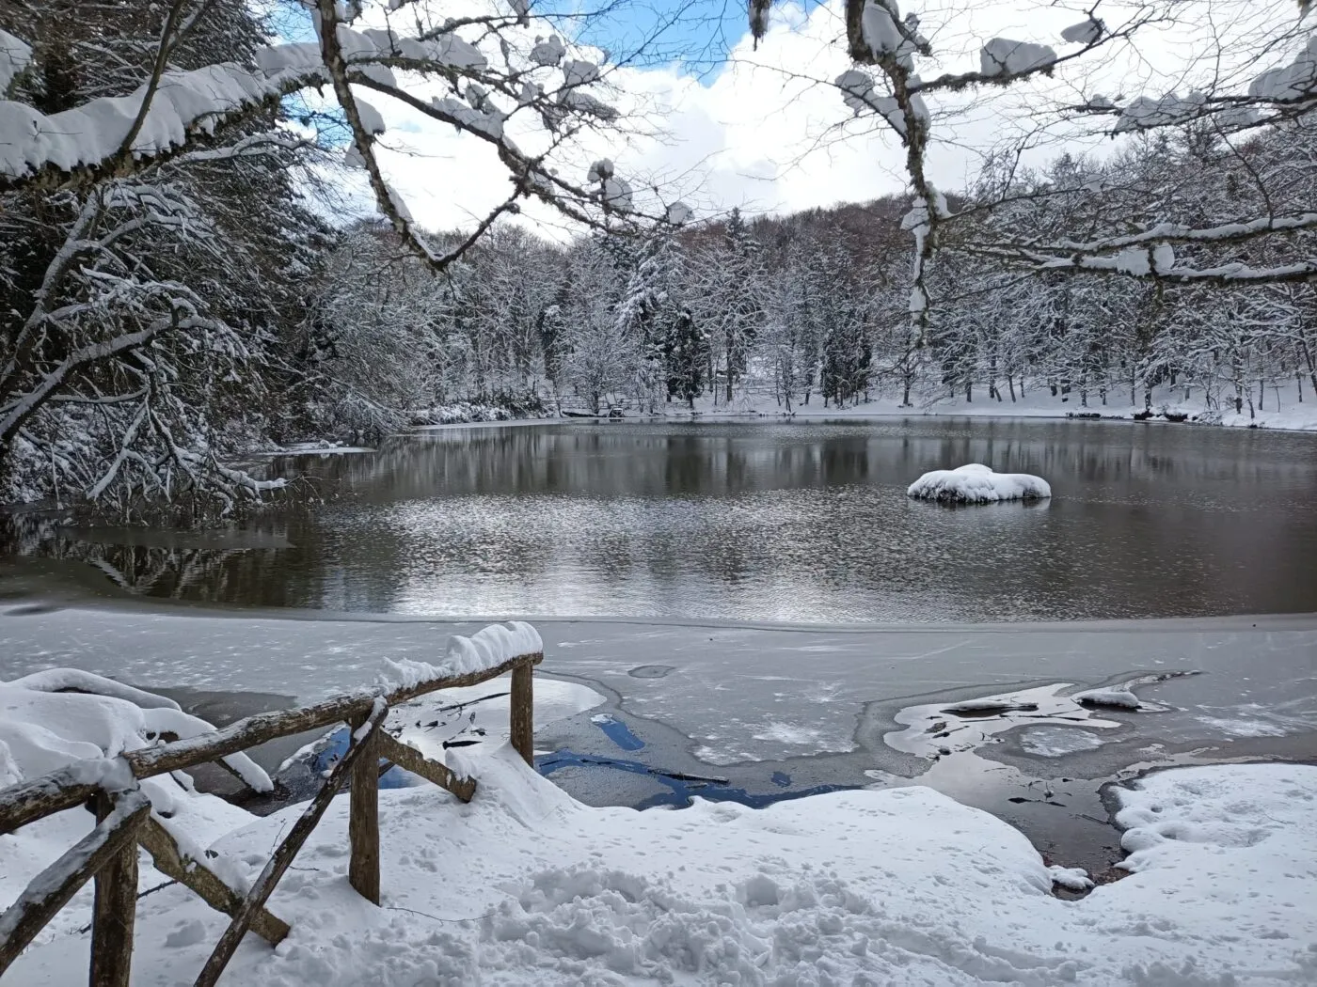
The Natural Reserve of “Foresta Umbra”
The “Foresta Umbra” is a forest area in Gargano National Park with river, lakes, mountains and plants. There are different types of plants (oaks, maple and chestnut trees) and animals (foxes, deer and boars) The climate is hot in summer and cold in winter.

Slide 8
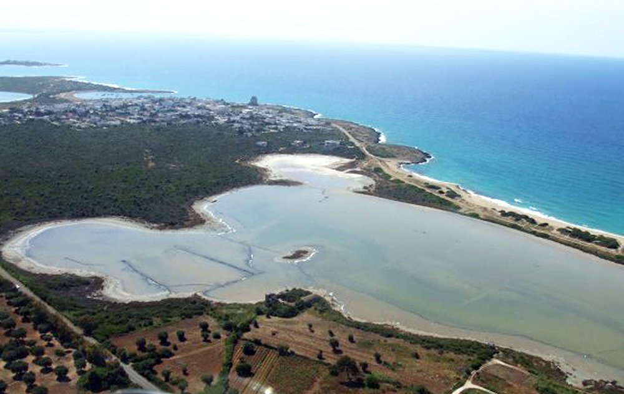
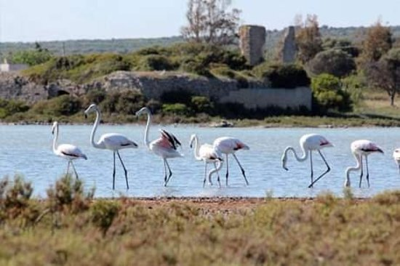
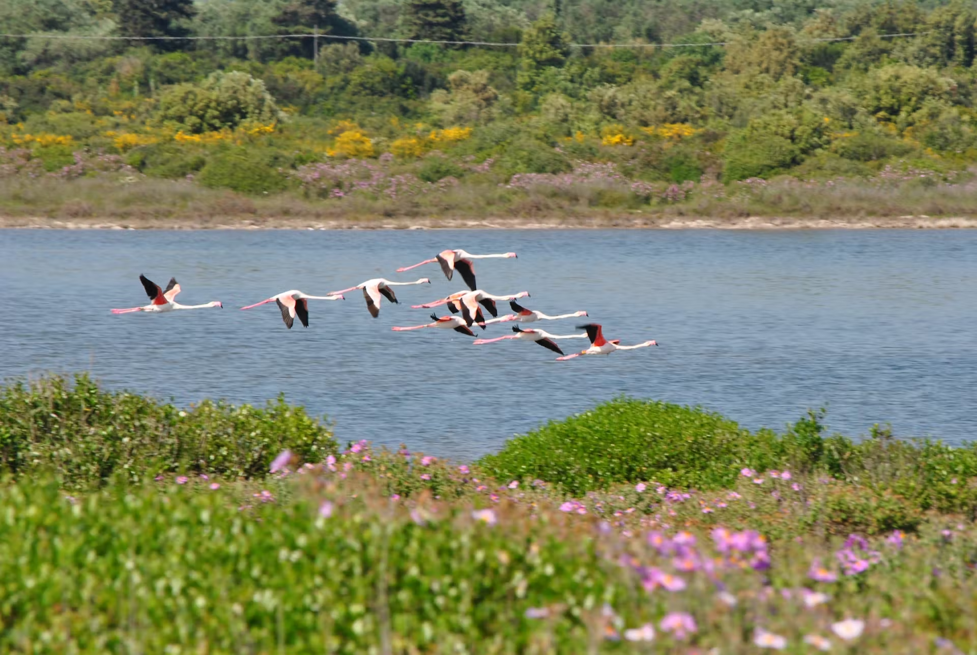
“Salina dei Monaci” Natural Reserve
“Salina dei Monaci” and the Dune Regional Reserve of Torre Colimena is a coastal site characterized by a disused salt pan. Here there are numerous herbaceous species like the thorny broom and a various amount of animal species, like flamingos.
Simone

Slide 9
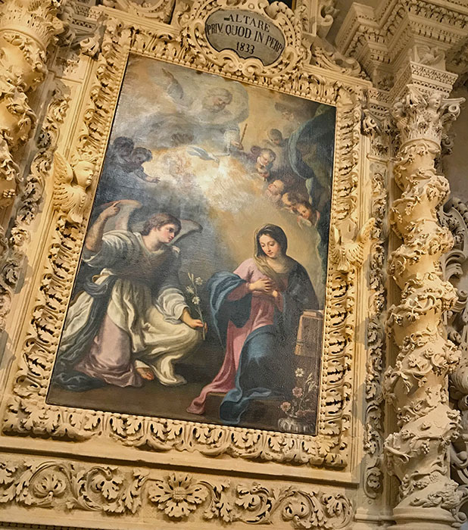
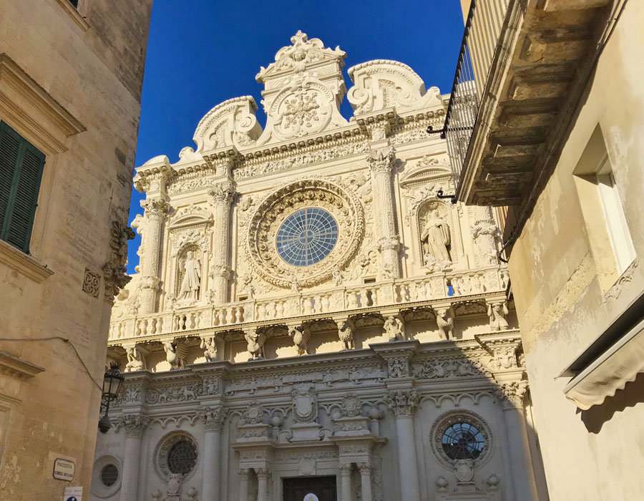
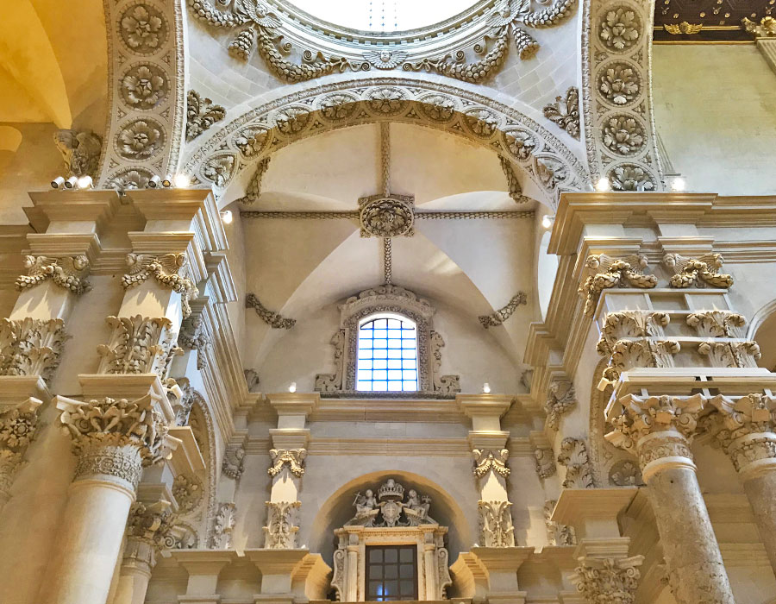
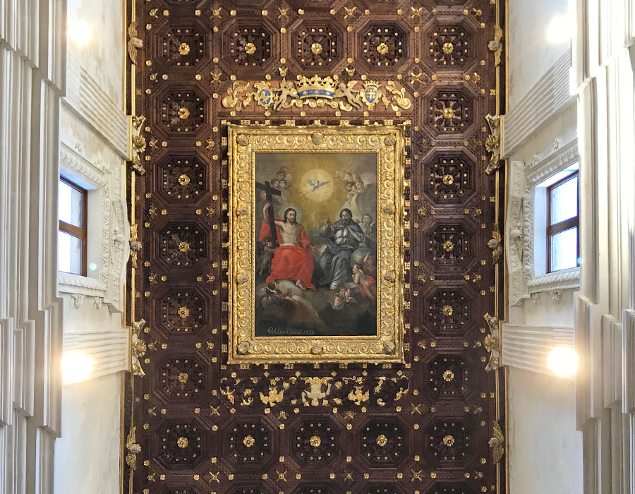
Basilica of Santa Croce in Lecce
Considered as the emblem of Lecce Baroque, the Basilica of Santa Croce is one of the most important and admired churches in Lecce that was completed in 1695.
Simone

Slide 10
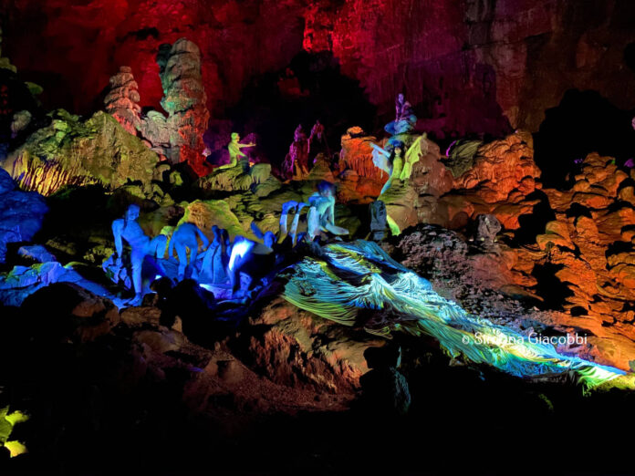
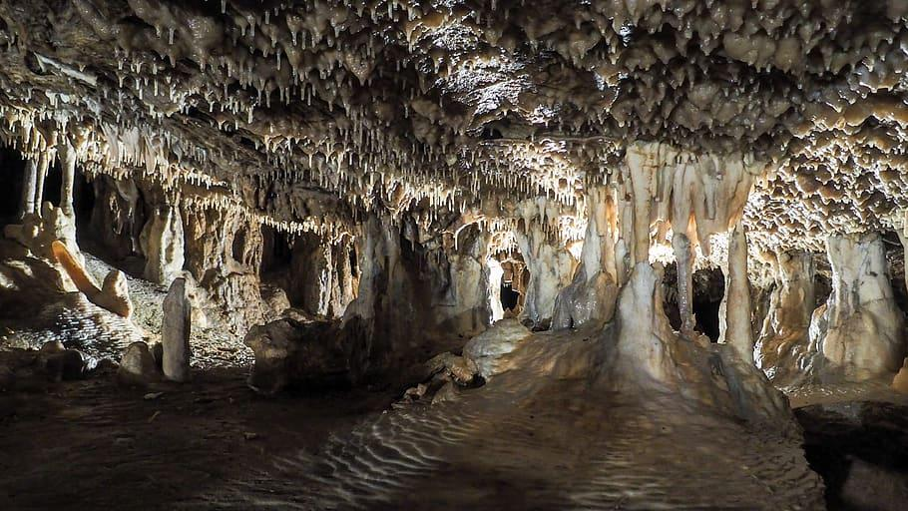
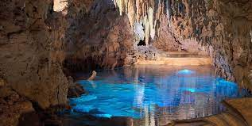
The Castellana Caves
This complex of underground caves of karst origins is among the most beautiful and spectacular in Italy. They are located in the Municipality of Castellana-Grotte near Bari.
They develop for a length of 3.348 Km and reach a maximum depth of 122 meters from the surface.
The temperature of the internal rooms is around 16.5°C.

Slide 11
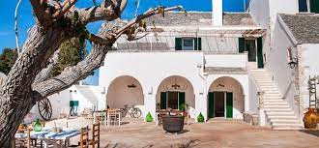
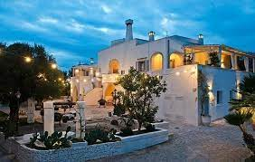
The Masseria
The word “masseria” is a bit difficult to translate into English. The main meanings would be fazenda, farm, or something similar to it. In fact it is a farm. Long time ago this was the purpose of what was called masseria. It looks like a typical construction of the sixteenth and seventeenth centuries and was originally the result of the colonization of royal nobles in those areas that were previously been abandoned.
A masseria was basically a large farm inhabited by the landowners, and included lodgings for the peasants working the land, stables, and warehouses for forage and crops.

Slide 12
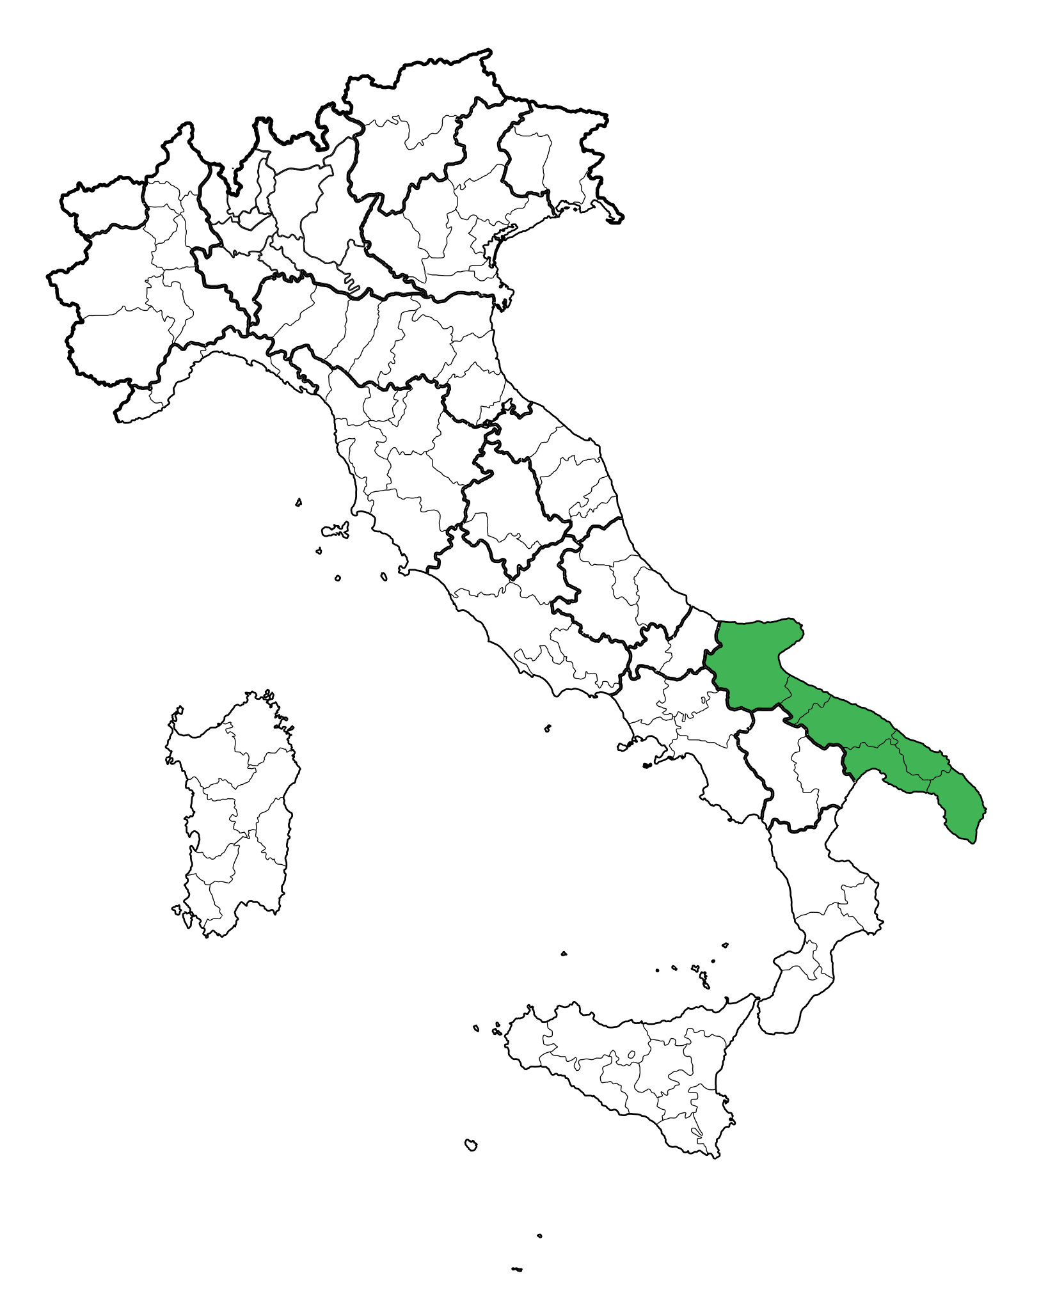
Our town: MASSAFRA
Massafra
Alberto

Slide 13
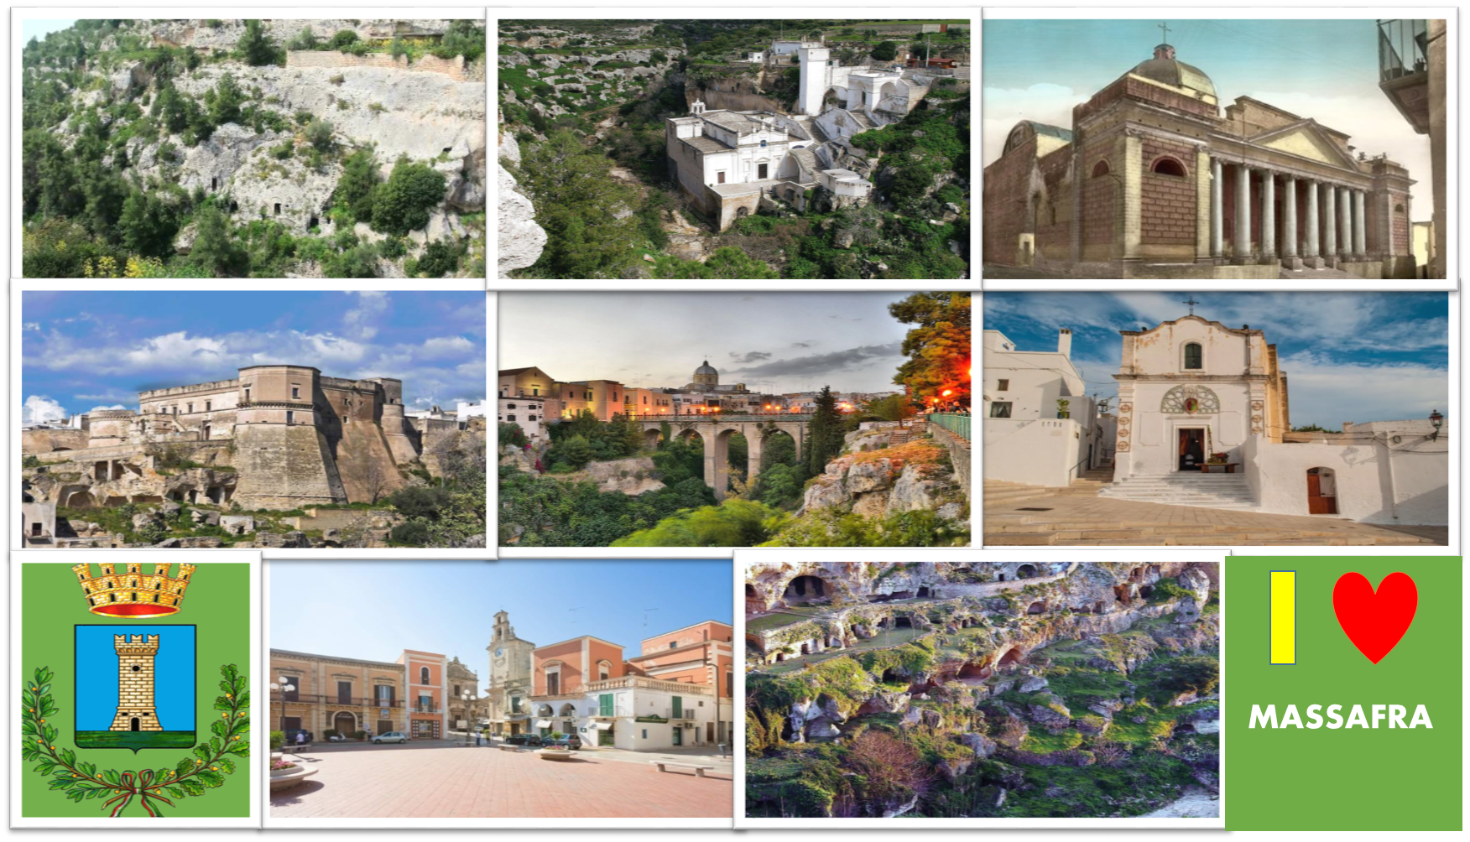
The cultural heritage of Massafra

Slide 14
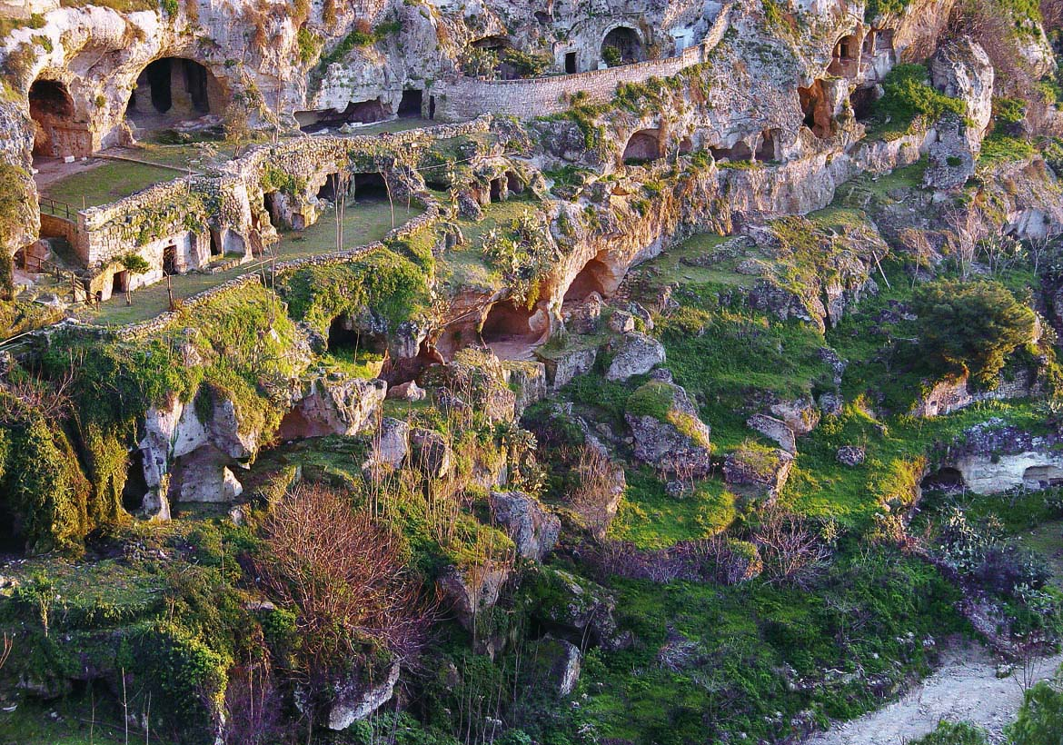
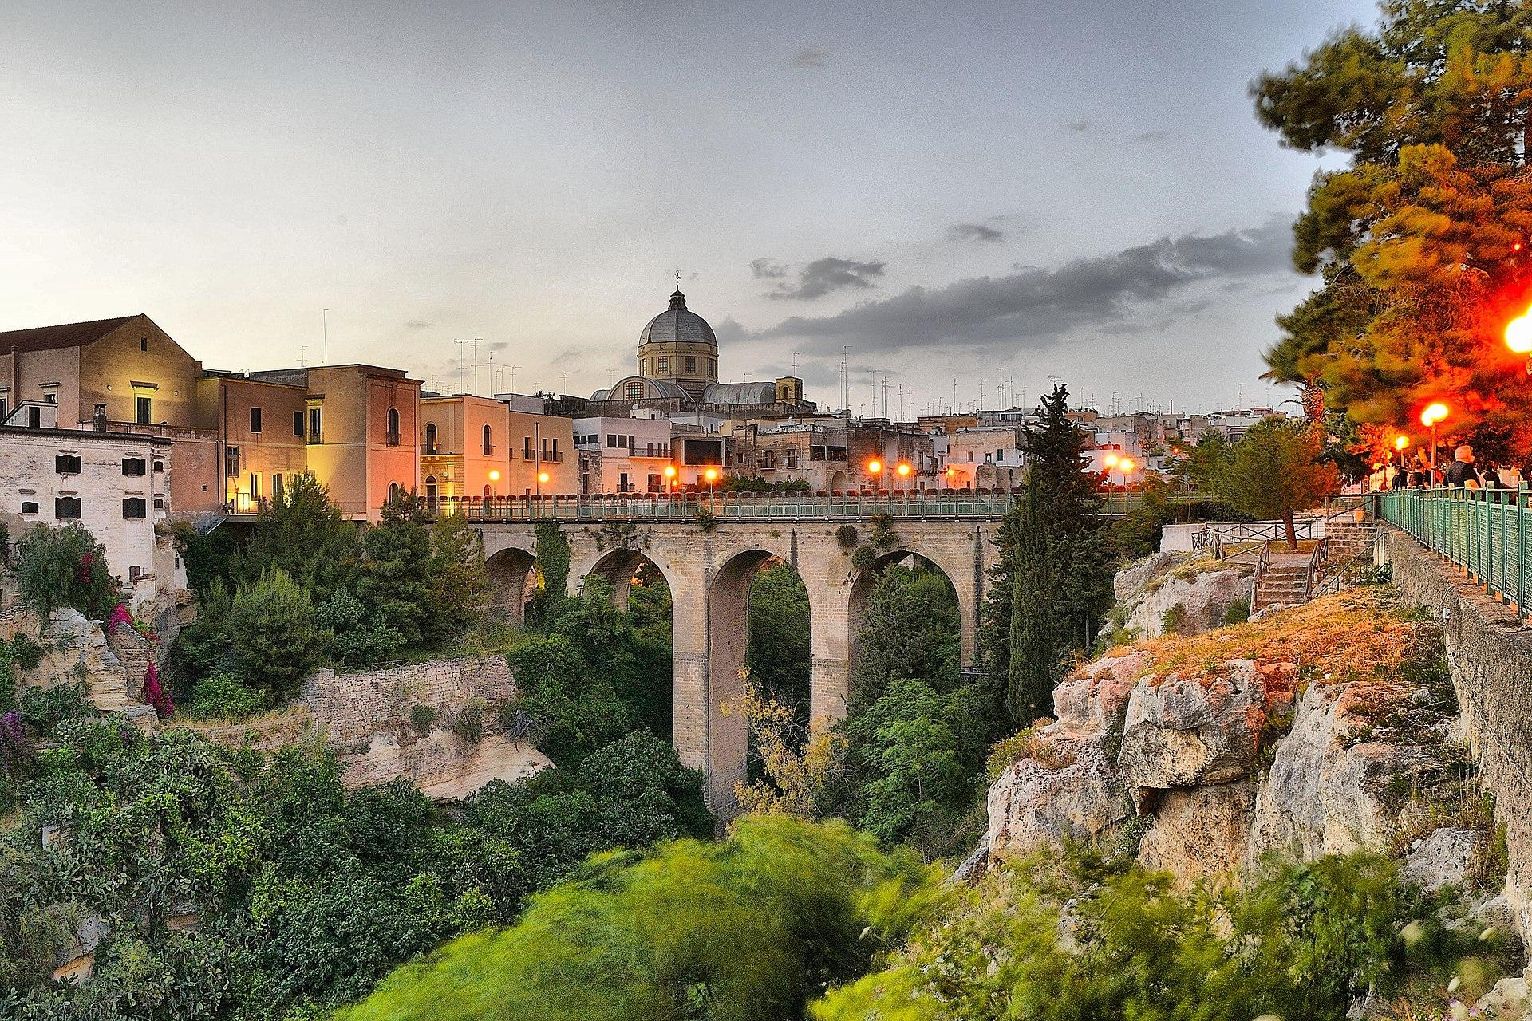
San Marco’s Ravine
San Marco's Ravine is a natural ravine located in the countryside in the town of Massafra. San Marco's Ravine is a popular destination for hiking, nature walks, and birdwatching, as it is home to many species of birds and other wildlife.
The ravine is characterized by a unique geology, vegetation, wildlife and limestone cliffs, which are all being threatened by the changing climate. Rising temperatures can alter the water cycle, leading to water scarcity and degradation of the vegetation. This can result in loss of biodiversity. Heavy rainfalls, which are becoming more frequent due to climate change, can cause erosion and destabilization of the delicate ravine slopes, leading to potential collapse.

Slide 15
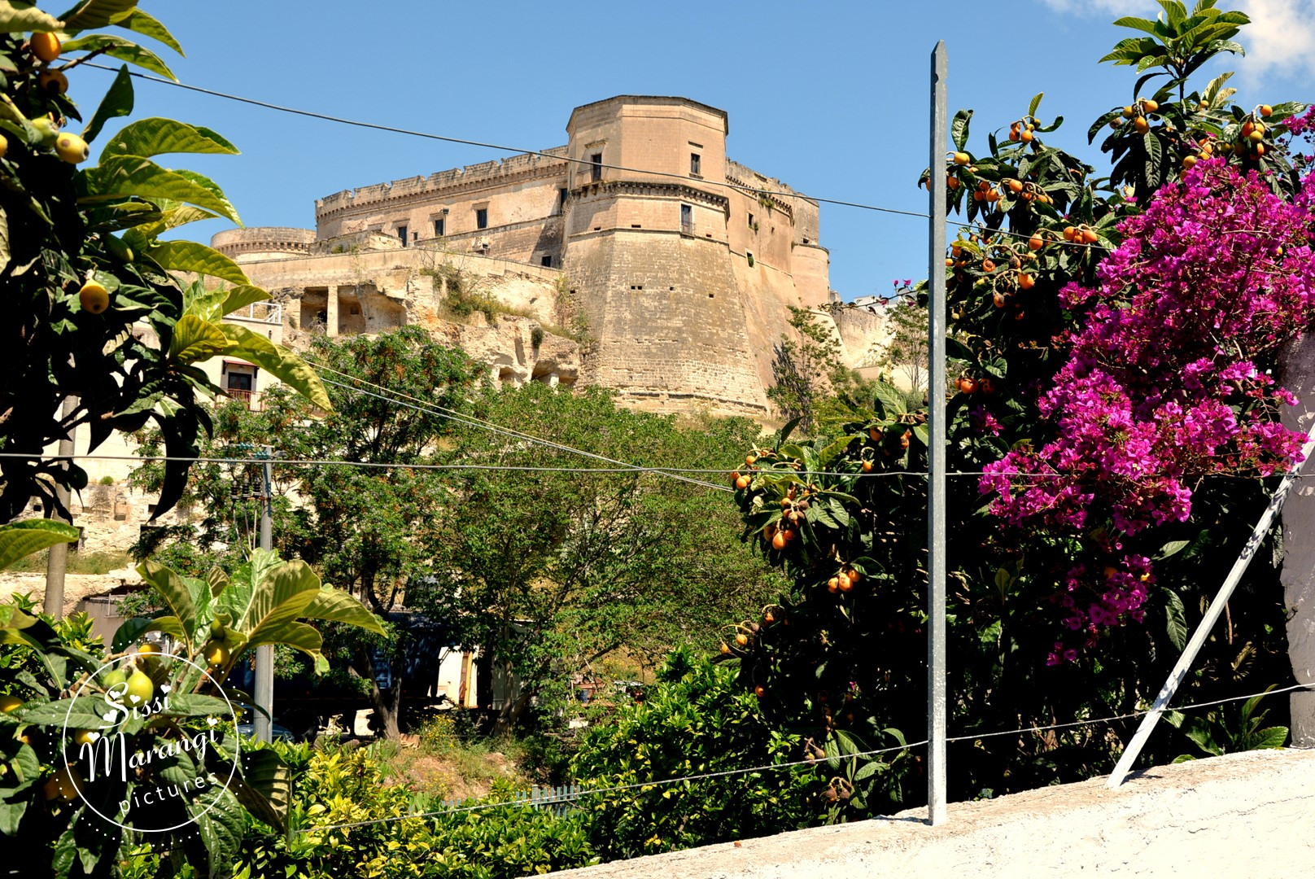
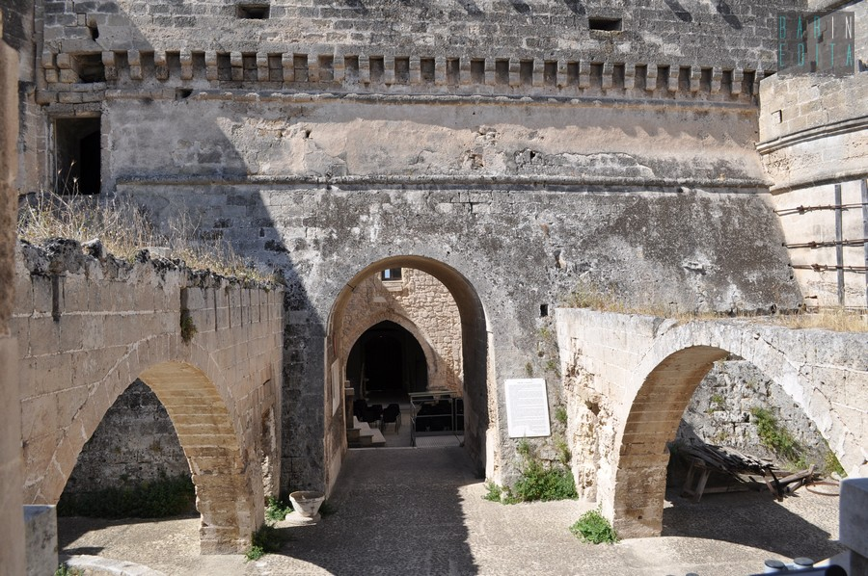
The Castle
The Castle of Massafra is a medieval fortress located in San Marco’s Ravine. It was built in the 10th century and has undergone several renovations over the centuries. Today, the castle is a popular tourist attraction and is known for its imposing defensive walls, towers, and panoramic views of the surrounding landscape.
The castle of Massafra is one of the historic buildings threatened by the impacts of the climate change. They can lead to structural damage, like cracking and erosion, putting the integrity of the castle at risk. Climate change also affects the surrounding ecosystem. This can lead to increased humidity levels inside the castle, promoting the growth of mold and other harmful organisms that can further deteriorate the structure.

Slide 16
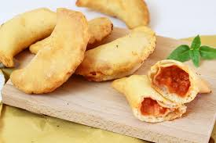
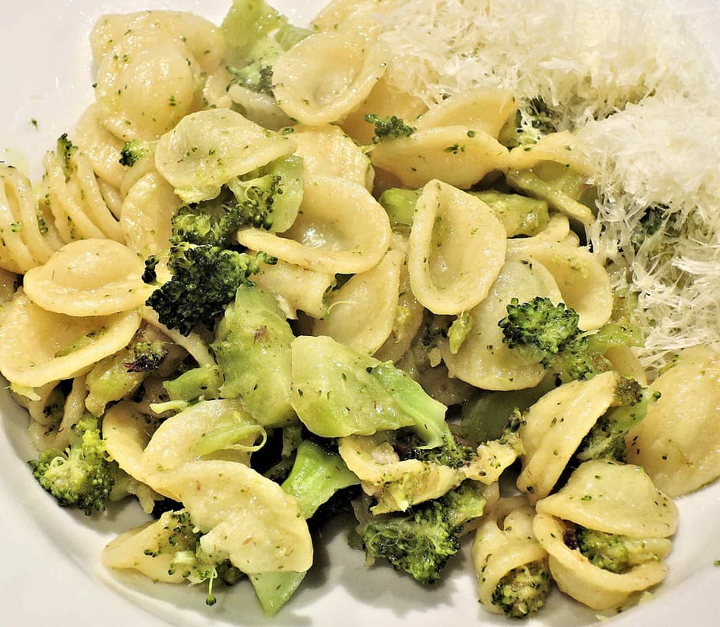
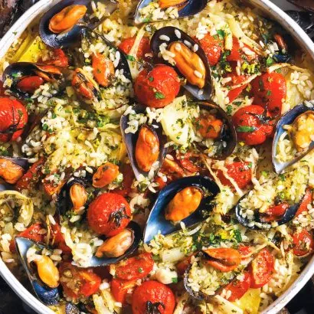
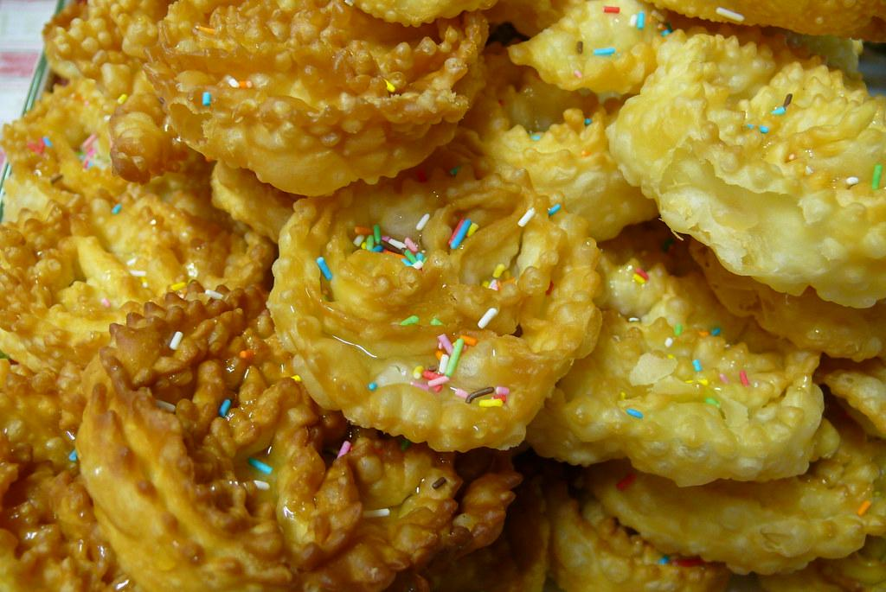
Apulian Food
ORECCHIETTE
Orecchiette are the symbol of Apulian gastronomy. They are prepared especially in Bari but are famous throughout Apulia.They are a kind of pasta usually seasoned with turnip greens.
RICE, POTATOES AND MUSSELS
This dish is made of rice, seafood and potatoes cooked in the oven. It is a variant of the Spanish paella, imported during the Bourbon domination of Apulia.
TYPICAL SWEETS
Cartellate are a typical Christmas and Apulian dessert. It dates back to the sixth century after Christ. They are seasoned with honey or wine. Other typical sweets are taralli, which can be sweet or salted.
PANZEROTTI
They are a sort of fried calzoni filled with mozzarella cheese, ham, tomato sauce. They are usually eaten at dinner, instead of pizza.
Mattia

Slide 17
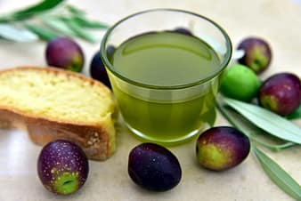
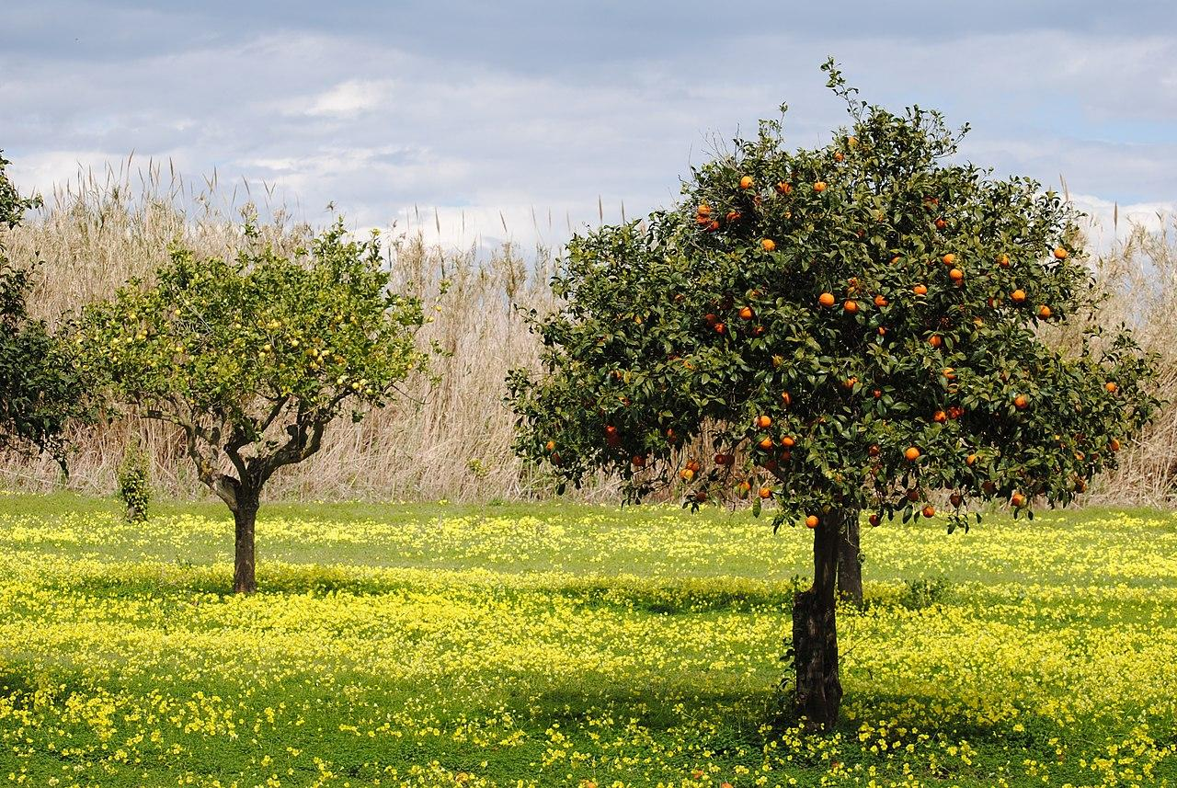
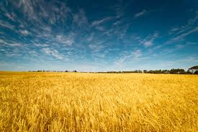
Typical productions of Apulia region
OLIVE OIL The Apulian landscape is dominated by 70% by olive trees and olive oil, which is a fundamental element for the Apulian cuisine
CITRUS FRUITS
Citrus fruits are one of the main productions in Apulia, in fact the fields are full of clementine, oranges and lemon trees.
WHEAT
Apulia region is the main Italian producer of durum wheat used to make pasta and bread.
Mattia

