Slide 1
PRIMARY SCHOOL `DESPOT STEFAN VISOKI` DESPOTOVAC

Slide 2
Primary school "Despot Stefan Visoki" is located in Despotovac. It wears the name of the famous Serbian ruler, the son of King Lazarus, Stefan the Great. The school was founded in 1876 and since then it has its present name. Today, about 720 students attend classes. The school has over 30 cabinets and classrooms, a hall for physical and outdoor sports fields. Foreign languages that can be learned at school are: English, Russian and French. An extended stay for students of the junior class was organized at the school.

Slide 3
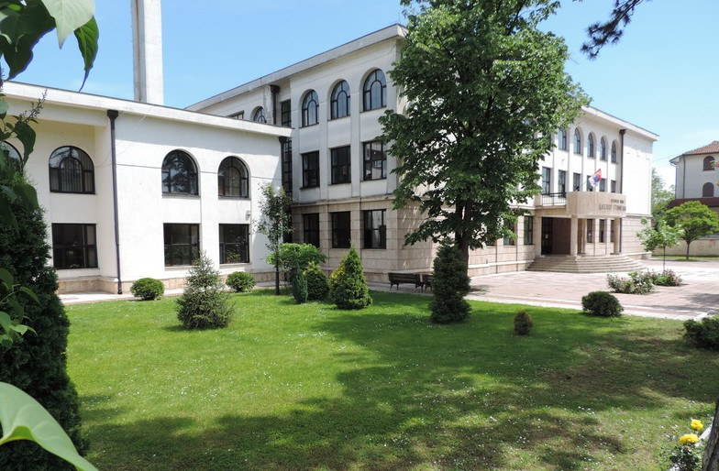

Slide 4
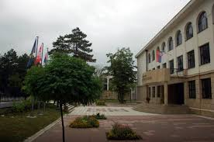

Slide 5
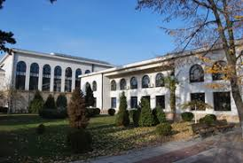

Slide 6
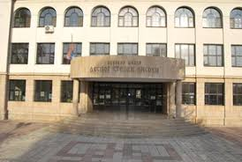

Slide 7
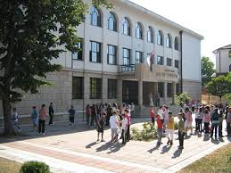

Slide 8
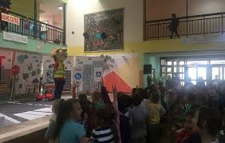

Slide 9
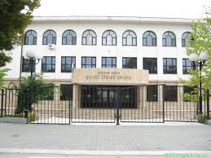

Slide 10
THANKS A LOT FOR BEING WITH US!

