Slide 1
LTT IN SLOVAKIA
Climate and Threats on Cultural Heritage
Erasmus + KA 229 – School exchange partnership
FROM 9TH – 14TH OCTOBER 2022
OS `DESPOT STEFAN VISOKI` - DESPOTOVAC - SERBIA
2020-1-ES01-KA229-082560_2

Slide 2
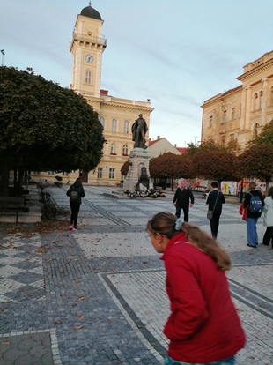
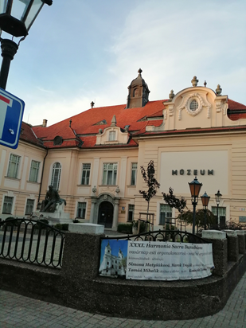
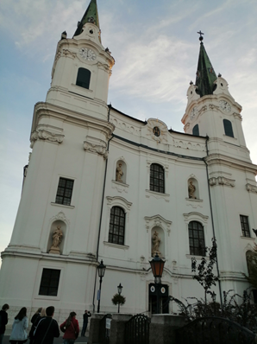
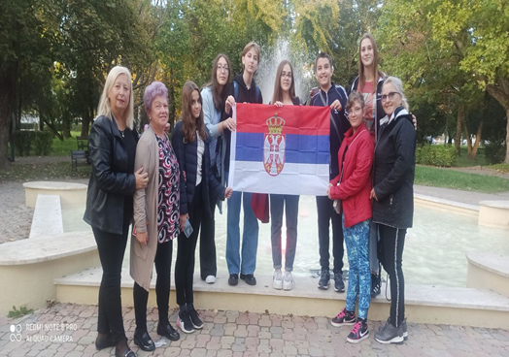
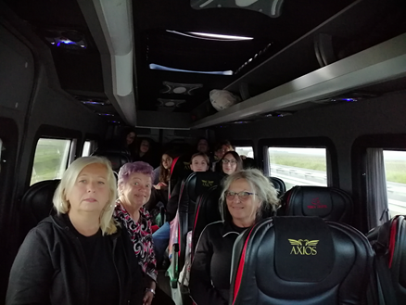
SUNDAY, OCTOBER 9TH 2022
WE TRAVELED BY A COMFORTABLE MINIBUS.
WE ARRIVED IN THE CITY OF KOMARNO IN SLOVAKIA AROUND 2:15 PM. WE ACCOMMODATED OURSELVES, RESTED A LITTLE AND WENT OUT TO WALK AROUND THE OLD PART OF THE CITY. AROUND 7PM WE MEET UP WITH OTHER GROUPS FROM TURKEY, SPAIN, ITALY, POLAND AND, OF COURSE, THE HOST COUNTRY OF SLOVAKIA. THE MEETING WAS VERY CORDIAL, WE WERE ALL LOOKING FORWARD TO MEETING AGAIN. WE WENT TO HOTEL EUROPA FOR DINNER.

Slide 3
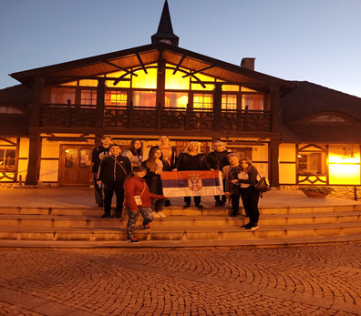
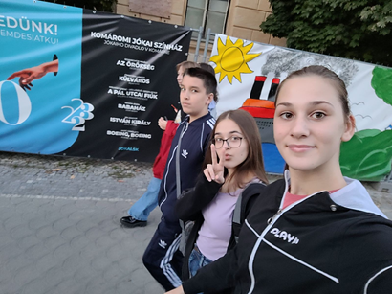
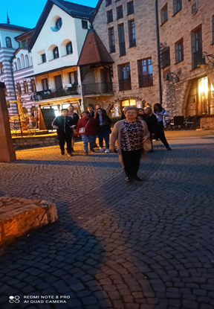
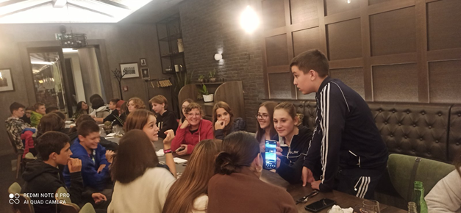
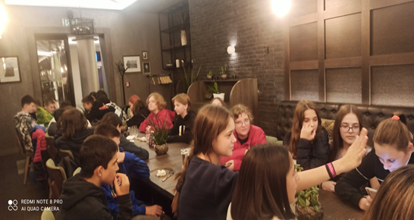
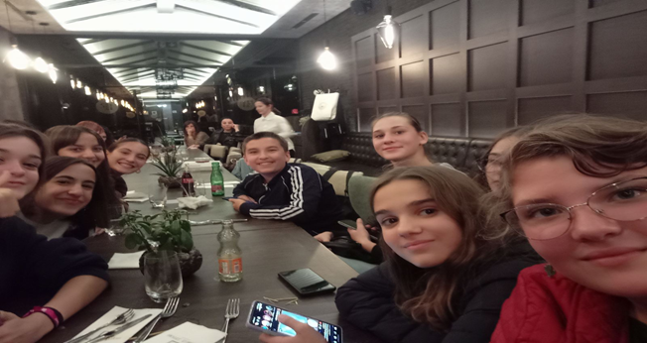

Slide 4
MONDAY, OCTOBER 10TH, 2022
WE WENT BY BUS TO THE PANNY MARIE SCHOOL IN KOLAROVO, WHERE OUR HOSTS GAVE US A BEAUTIFUL WELCOME. WE WERE GREETED BY OUR HOSTESS TIMEA, THE SCHOOL DIRECTOR AND THE MAYOR OF KOLAROVO. THE STUDENTS OF THEIR SCHOOL SHOWED US A PRESENTATION AND TALKED ABOUT KOLAROVO AND THE SCHOOL ITSELF. THEN WE TOURED THE SCHOOL WHICH WAS RENOVATED AND OPENED IN APRIL 2022.
AND THEN THE GUEST STUDENTS HAD THE ACTIVITY OF GETTING TO KNOW EACH OTHER WITH THE GOAL OF INTEGRATION, WITH SERVICE. DURING THAT TIME, THE GUEST TEACHERS MET THE SCHOOL DIRECTOR, GAVE HIM GIFTS AND WERE SERVED DRINKS, COFFEE, CAKE.
AFTER LUNCH, WE HAD A PRESENTATION ON THE NEGATIVE IMPACTS OF CLIMATE CHANGE ON NATURE AND CULTURAL HERITAGE ON A GLOBAL AND LOCAL LEVEL. THE PRESENTATOR WAS ŽOLT RIFLIK, PRESIDENT OF THE ORNITHOLOGY SOCIETY KOLAROVO, THE ENGLISH LANGUAGE TEACHER TRANSLATED THE PRESENTATION FROM HUNGARIAN TO ENGLISH LANGUAGE.

Slide 5
THEN WE WENT BY BUS TO THE TRADITIONAL HUNGARIAN FARM VERMES. THERE WE DIVIDED INTO 2 GROUPS AND PARTICIPATED IN WORKSHOPS. THE FIRST GROUP VISITED A TRADITIONAL HUNGARIAN YURT (CHIEF OF THE VERMES TRIBE), A HUGE ROUNDED TENT, WHERE THE YURT EQUIPMENT WAS SHOWN AND THE NOMAD WAY OF LIFE OF THE HUNGARIAN TRIBES WAS TOLD ABOUT. DURING THAT TIME, ANOTHER GROUP TRIED RIDING THE HORSES WHICH WERE VERY TREAD AND CALM. IT WAS AN UNSEEN EXPERIENCE FOR ALL THE STUDENTS. AFTER THE HOUR AND A HALF, THE GROUPS CHANGED. AND THEN ALL THE STUDENTS PARTICIPATED IN ARCHERY, TRIED OLD WEAPONS, PLAYED GAMES FROM THE AGE OF THE HUNGARIAN CONQUESTS, AND MANY OTHER ACTIVITIES. DINNER WAS ORGANIZED FOR US ON THE FARM (TRADITIONAL HUNGARIAN STEW), AS WELL AS A TRADITIONAL HUNGARIAN DANCE EVENING WITH PROFESSIONAL DANCERS AND A DANCE LESSON IN WHICH THE STUDENTS LEARNED THE STEPS OF SEVERAL DANCES AND THEN ALL DANCED.

Slide 6
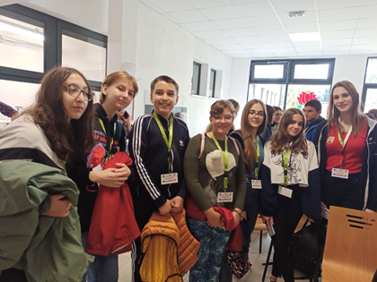
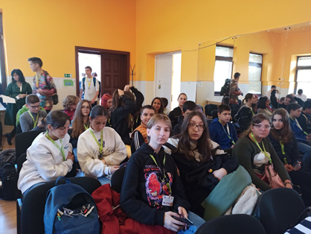
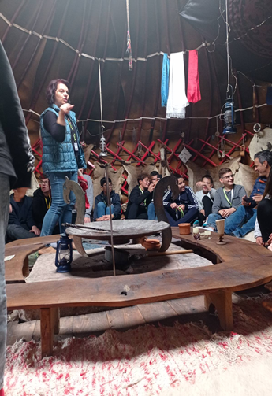
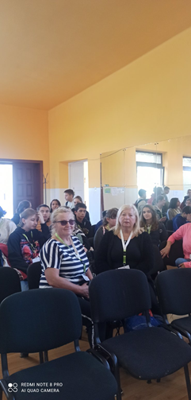
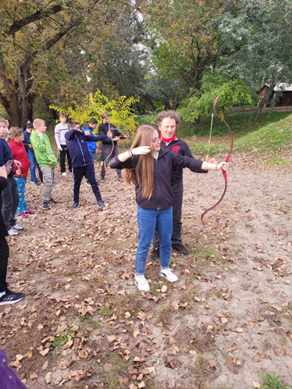
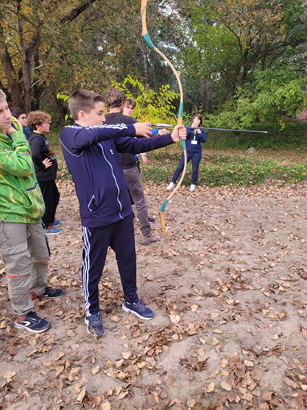

Slide 7
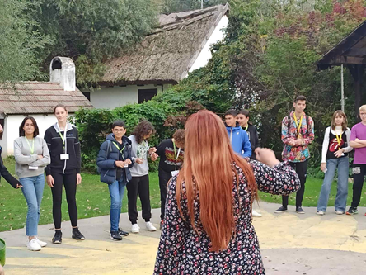
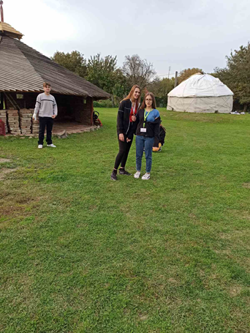
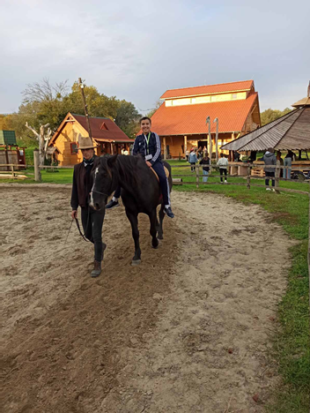
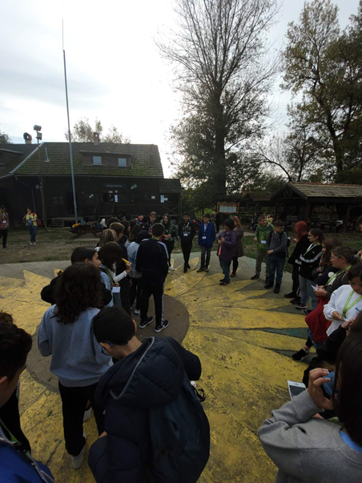

Slide 8
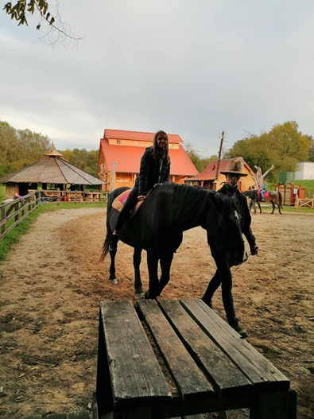
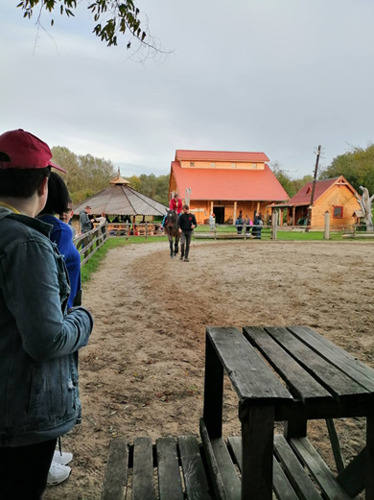
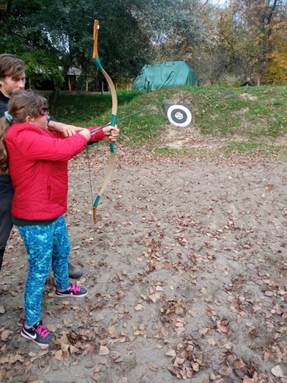
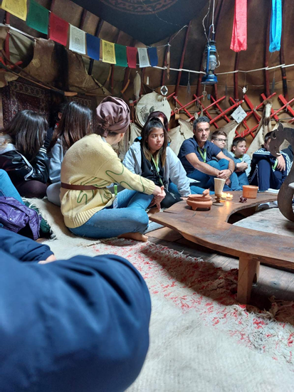
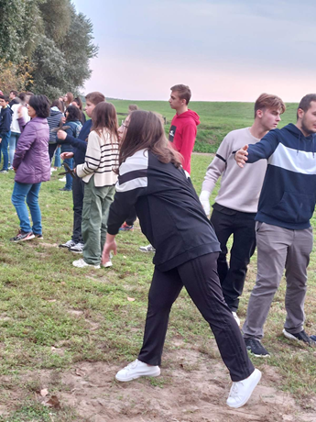
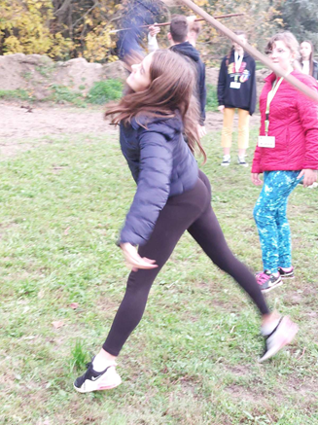
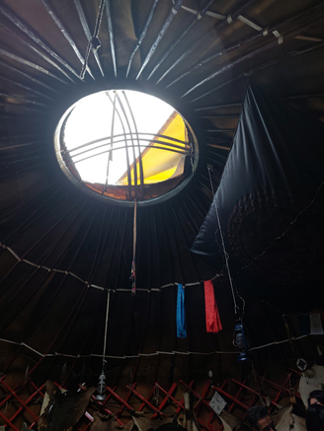
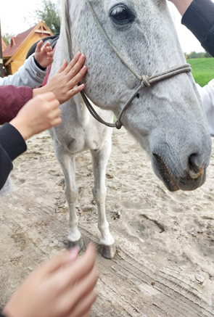

Slide 9
TUESDAY, OCTOBER 11TH, 2O22
IN THE MORNING, AFTER BREAKFAST, WE HEADED TO BUDAPEST.
WHEN WE ARRIVED, WE TOURED THE BUDAPEST CASTLE WITH A BEAUTIFUL VIEW OF THE CITY. AFTER LUNCH BREAK, WE WENT FOR THE DANUBE CRUISE.
WE LISTENED TO THE STORIES ABOUT BUDAPEST AND THE DANUBE. WE SAW THE DANUBE COASTLINE AND THE BEAUTY OF BUDAPEST.
AFTER GETTING OFF THE SHIP, WE HAD FREE TIME ON THE SQUARE. WE TRIED THE FOOD AND LOOKED AT THINGS IN THE CITY.
AT FIVE O'CLOCK FOLLOWED THE RETURN TO KOMARNO FOR DINNER, AND THEN WE RETURNED TO THE HOTEL.

Slide 10
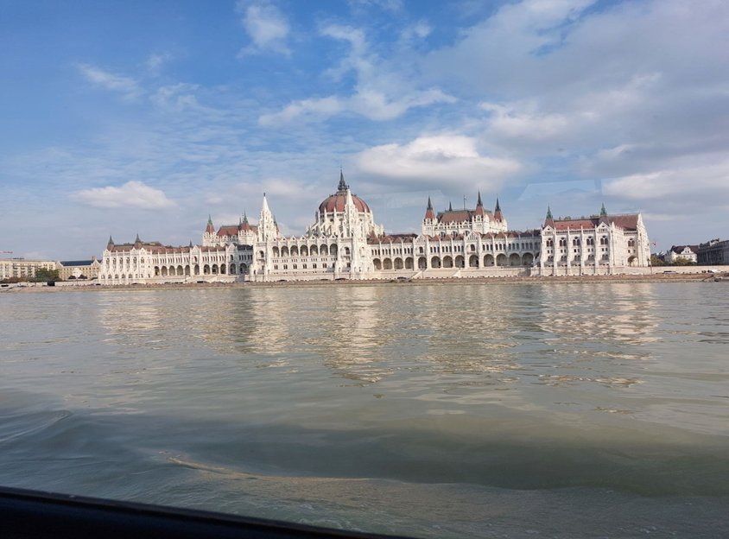
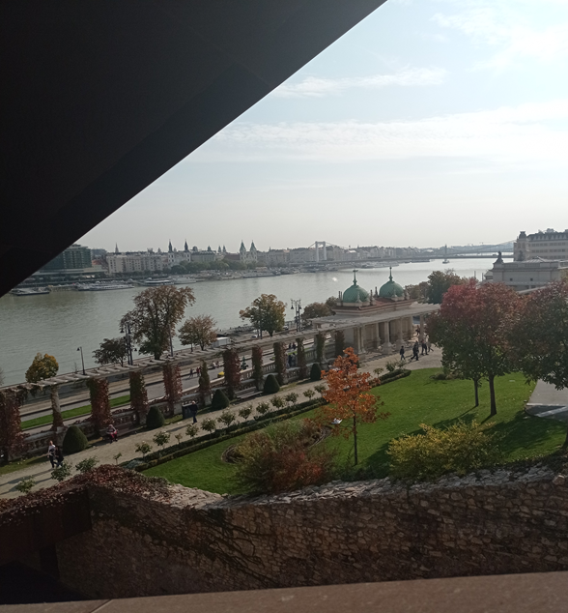
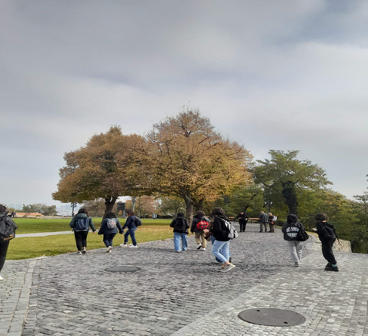
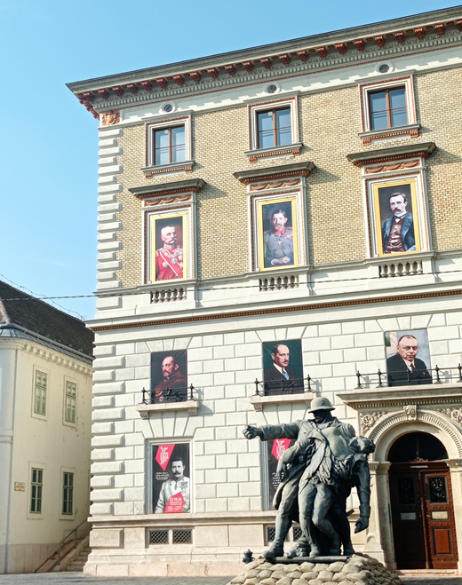
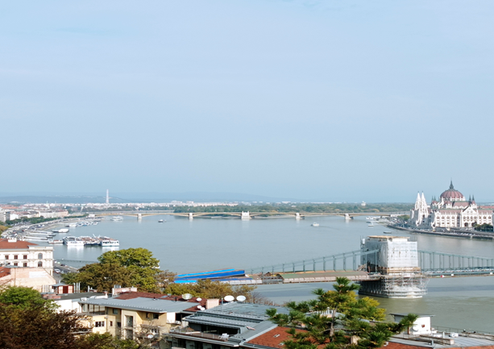

Slide 11
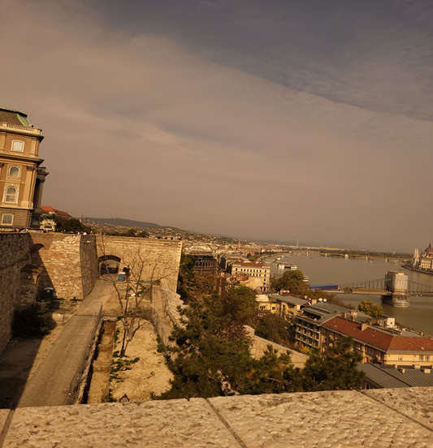
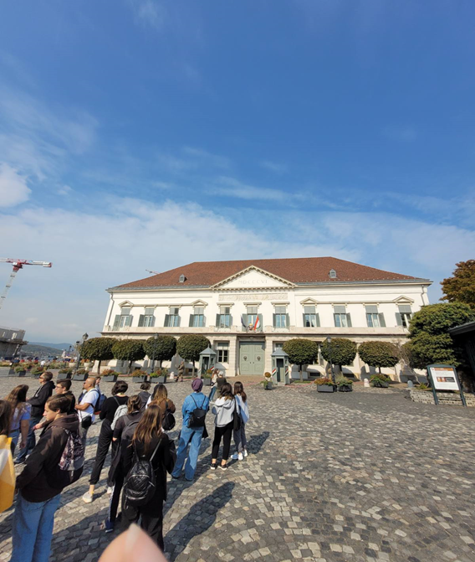
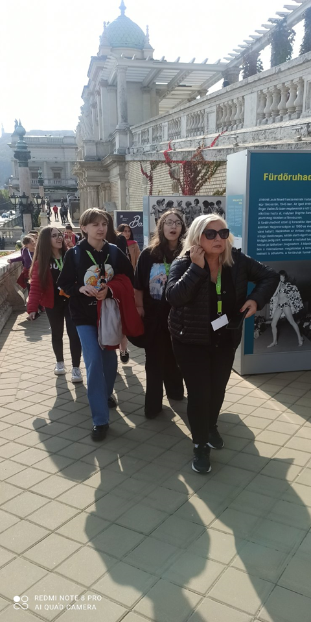
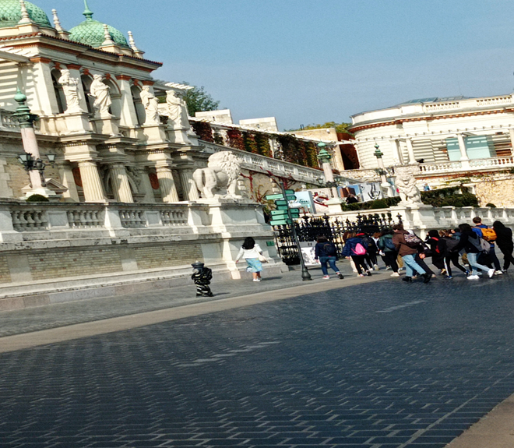

Slide 12
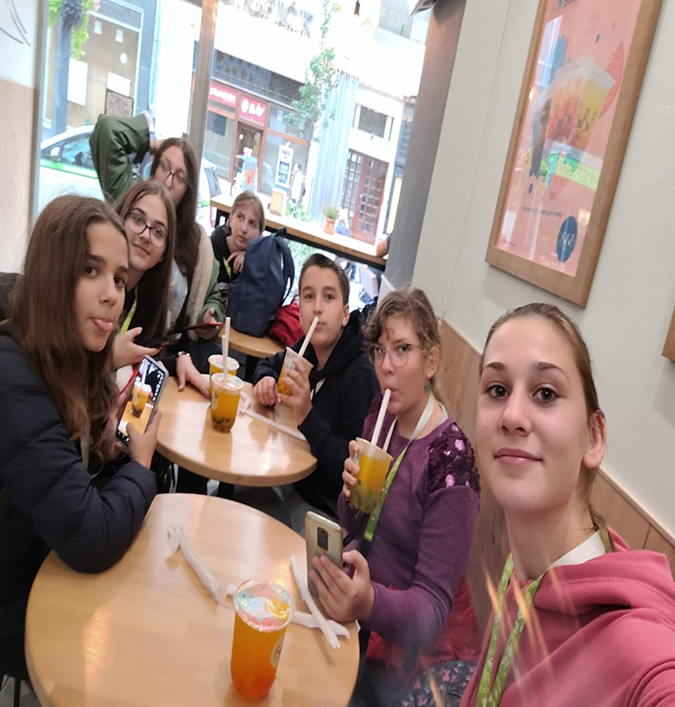
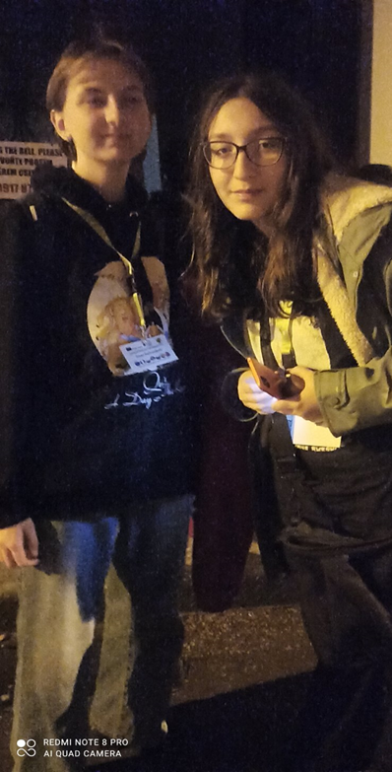
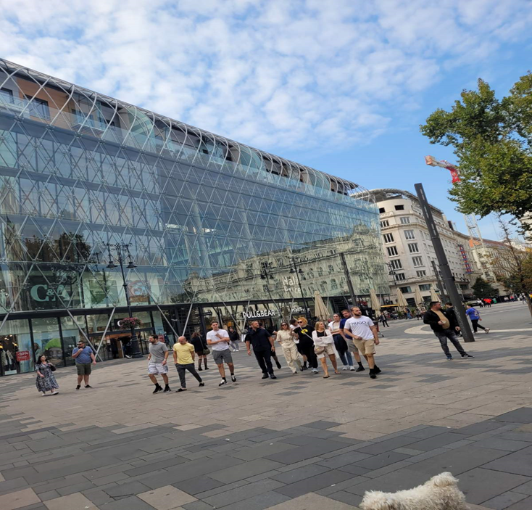

Slide 13
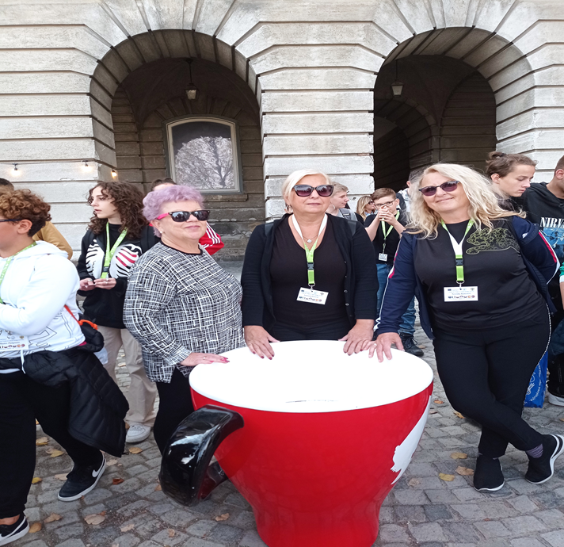
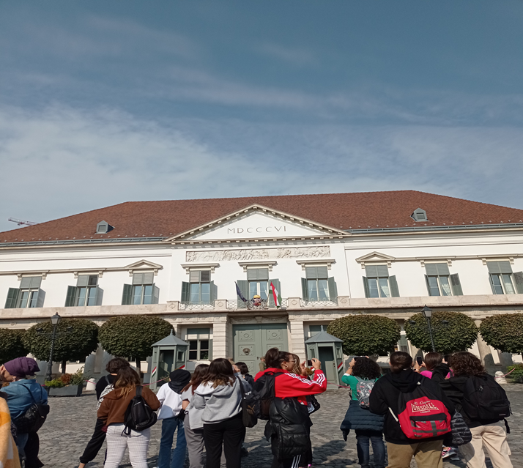
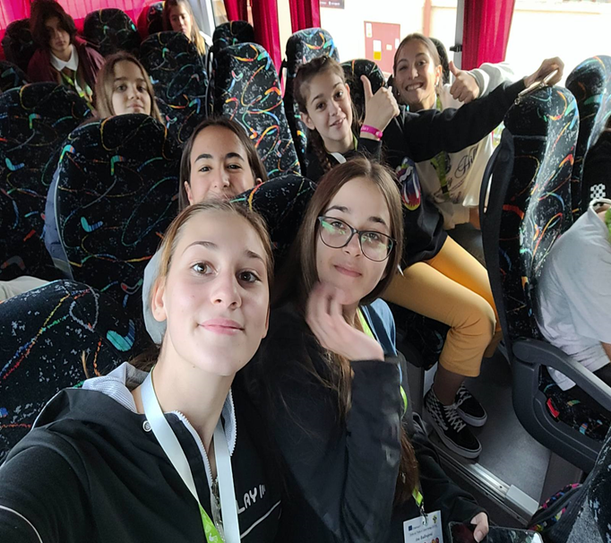
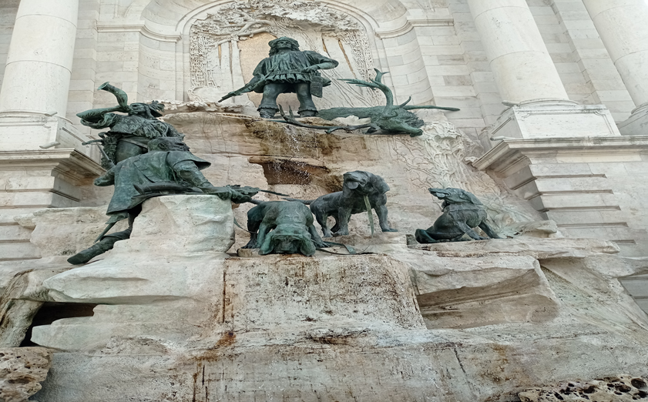

Slide 14
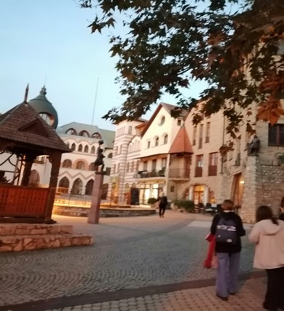
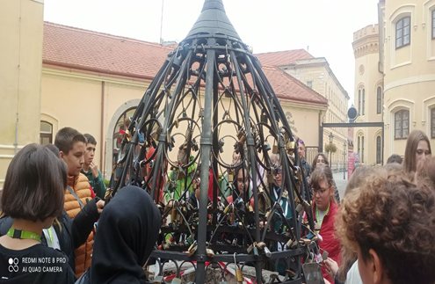
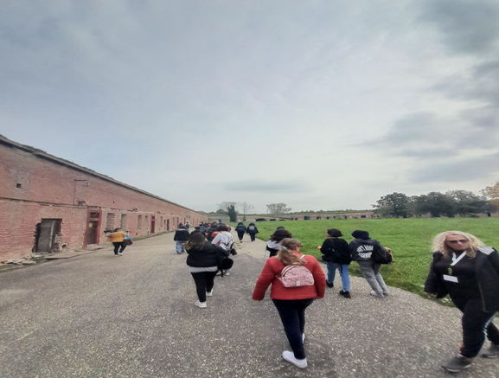
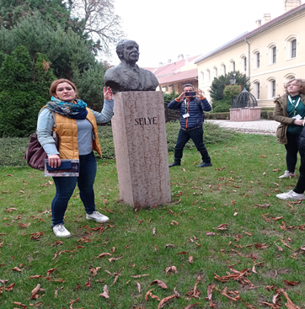
WEDNESDAY. OCTOBER 12TH, 2022
ON WEDNESDAY WE COULDN'T GO TO SCHOOL BECAUSE OF PROBLEMS WITH THE BUS SO WE TOURED THE TOWN OF KOMARNO.
WE WALKED AROUND THE SQUARE AND THEN HAD A BREAK.
WE ALSO TOURED A SQUARE OF 25 HOUSES, EACH HOUSE IN THE SQUARE REPRESENTED ONE COUNTRY.AFTER THAT WE WENT TO LUNCH.
AFTER LUNCH WE HAD A QUIZ ABOUT THE SQUARE. EACH GROUP HAD TO FIND A HOUSE OR MONUMENT FROM THE LIST.

Slide 15
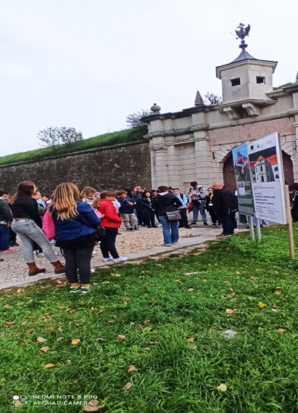
WHEN WE FINISHED THE QUIZ WE TOURED THE OLD TOWN.AFTER THE TOUR WE WENT TO DINNER.WE WALKED A LITTLE MORE AFTER DINNER, THEN WE WENT BACK TO THE HOTEL.

Slide 18
THURSDAY, OCTOBER 13TH, 2022
ON THURSDAY, WE WENT EARLY IN THE MORNING TO BRATISLAVA.
THERE WE TOURED THE CASTLE AND THE ESTATE AROUND IT. THE GARDEN WAS BEAUTIFUL, WE DIDN'T KNOW WHERE TO LOOK FIRST.
THEN WE TOURED THE MAIN SQUARE WHERE WE HAD A BREAK.
AFTER THE BREAK WE WENT TO LUNCH ON THE WAY LOOKING AT STRANGE SCULPTURES.

Slide 19
AFTER LUNCH WE RETURNED TO THE HOTEL TO GET READY FOR THE EVENING PARTY. AT SEVEN O'CLOCK WE WERE WARMLY WELCOME IN FRONT OF THE SCHOOL BY THE STUDENTS WHO PARTICIPATED IN THE PROJECT. THERE WAS A DELIVERY OF CERTIFICATES FOR ALL PROJECT PARTICIPANTS IN THE SCHOOL. THERE WAS DINNER AT SCHOOL. AFTER DINNER WE ALL DANCED TOGETHER AND HAD A GREAT TIME. AT THE END OF THE PARTY, EVERYONE ATE A BIG CAKE WITH PICTURES OF THE FLAGS OF ALL THE COUNTRIES PARTICIPATING IN THE PROJECT. AFTER THE PARTY EVERYONE SAID GOOD-BYE AND WE RETURNED TO THE HOTEL.

Slide 22
FRIDAY, OCTOBER 14TH, 2022
ON FRIDAY WE LEFT BACK TO SERBIA. AFTER BREAKFAST WE PACKED INTO THE MINIBUS AND THUS ENDED OUR TRIP.
THIS WAS A WONDERFUL EXPERIENCE THAT EVERYONE WILL REMEMBER.

