Slide 1
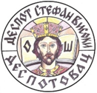
Erasmus + KA 229 – School exchange partnership
CATCH – Climate And Treats To Cultural Heritage
2020-1-ES01-KA229-082560_2
OS `DESPOT STEFAN VISOKI` - DESPOTOVAC - SERBIA

Slide 2
OUR COUNTRY, OUR TOWN, OUR SCHOOL

Slide 3
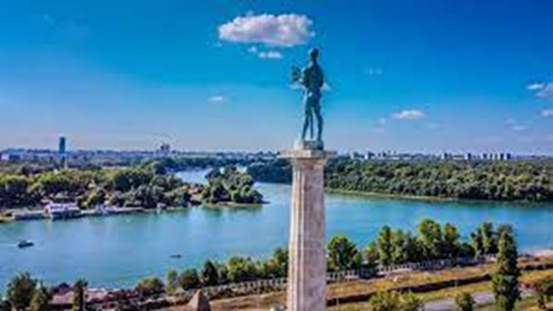
Serbia, officially the Republic of Serbia , is a landlocked country in Southeast Europe, at the crossroads of the Pannonian Plain and the Balkan Peninsula, bordering Hungary, Romania, Bulgaria, North Macedonia, Croatia and Bosnia and Herzegovina, Montenegro, and with Albania. Serbia has a population of almost 7 million, with Belgrade as its capital and largest city.

Slide 4
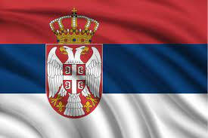
Serbia is unitary parliamentary constitutional republic. Serbia is an upper-middle income economy. The country provides universal health care and free primary and secondary education to its citizens.

Slide 5
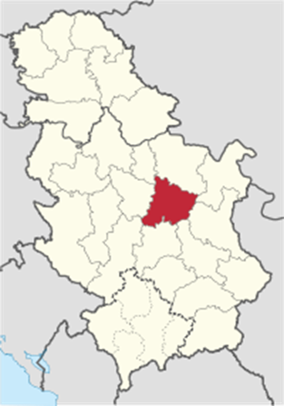
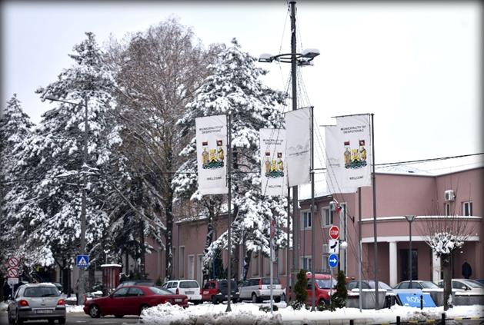
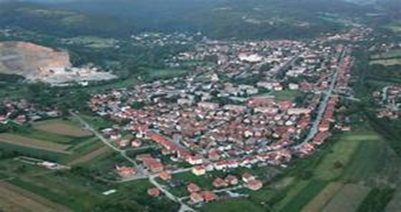
DESPOTOVAC
This is the town where we live.
In 1381, in the charter of Prince Lazar, Despotovac was mentioned for the first time as the village Vojnik.
This village was inhabited and displaced several times during the five-century rule of the Turks.
Just in 1882, by decree of King Milan Obrenovic, and in honor of the despot Stefan Lazarevic, this village was named Despotovac. With this decree, Despotovac was declared a town, and it is in Pomoravlje district.

Slide 6
COAT OF ARMS AND THE FLAG OF DESPOTOVAC

Slide 7
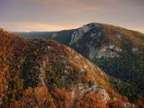
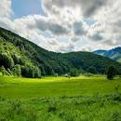
Despotovac is a place where rich history, culture and fascinating untouched nature intertwine. It is tucked away between the ranges of the Kucaj Mountains in the west and the beautiful plains in the east, its interesting past awakens the imagination, and its unique natural wealth awakens all senses.

Slide 8
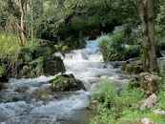
Today, Despotovac is a peaceful place in the east of Serbia, whose silence is only `disturbed` by the sounds of the Resava River. It springs below mountain Beljanica and it`s the largest river in the district.

Slide 9
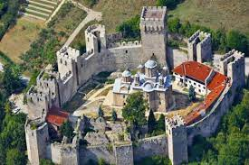
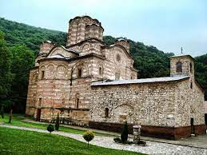
Despotovac abounds in natural wealth, river flows, diverse flora and fauna, has a favorable geographical location and climate, and was a center of spirituality and culture in the Middle Ages. Thanks to that, this area has, not only natural, but also cultural and historical wealth, the most important of which are the monasteries of Manasija and Ravanica.
Manasija monastery is located 3 kilometers from the town. It is the largest endowment of Despot Stefan Lazarevic.

Slide 10
This is Veliki Buk waterfall, it is also part of the Resava river. It is located in village Lisine.

Slide 11
This is the Resava cave, located 20 kilometers from Despotovac. It was discovered in 1962, but was opened to visitors in 1972. It is currently a tourist destination.

Slide 12
This is mountain Beljanica, the highest peak is 1339 meters high.

Slide 13
This is our primary school `Despot Stefan Visoki`

Slide 14
Primary school "Despot Stefan Visoki" is situated in Despotovac. It has the name of the famous Serbian ruler, the son of King Lazarus, Stefan the Great.
The school was founded in 1876 and since then it has had its present name. Today, about 540 students attend our school. The school has over 30 classrooms and cabints, a sports hall for P.E. and outdoor sports fields.
Foreign languages that can be learnt at school are: English, Russian and French. An extended stay for students of the junior classes was organized at school.

Slide 15
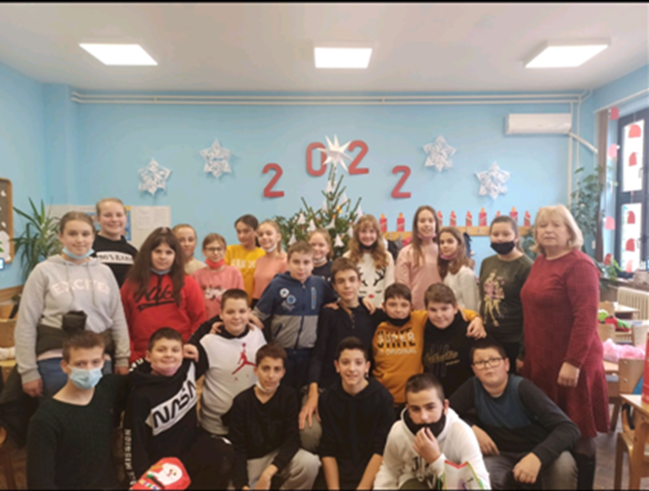
Here are some of our most beautiful classrooms

Slide 16
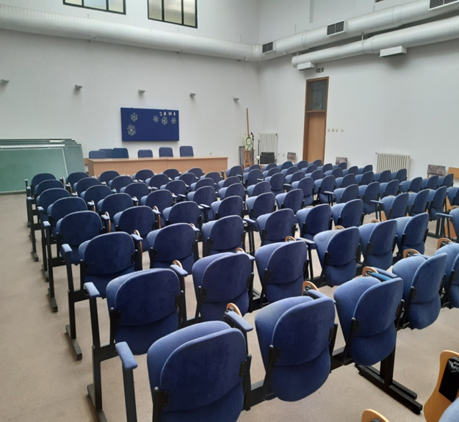
Congress hall

Slide 17
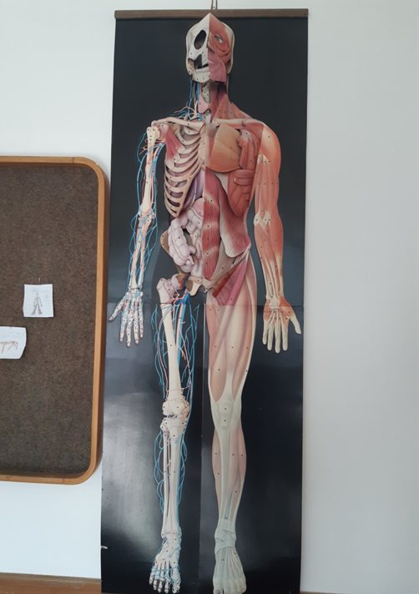
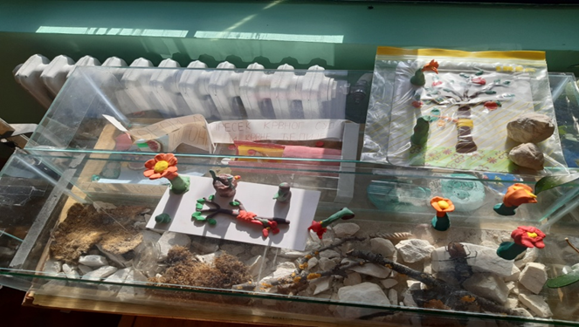
Biology cabinet

Slide 18
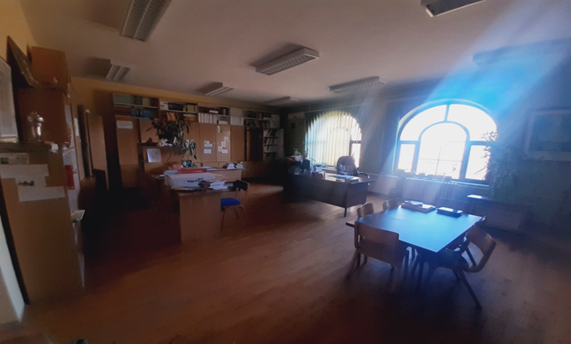
Library

Slide 19
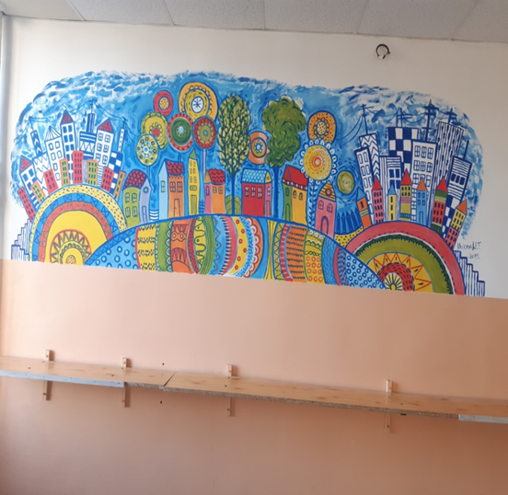
School kitchen

Slide 20
Our Main Hall

Slide 21
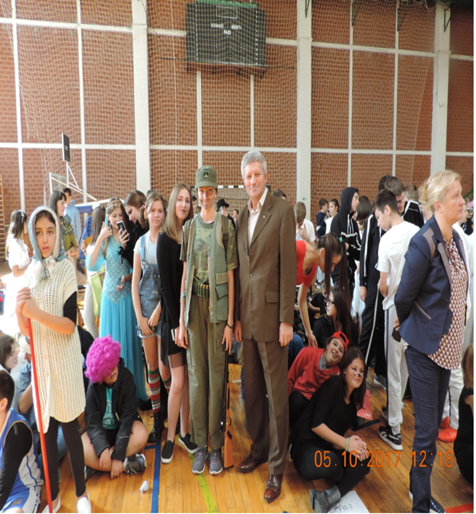
Sports Hall Besides for the P.E. classes and the sports events, we use our sports hall for some special events like best costumes, Christmas tournaments and many others.

Slide 22
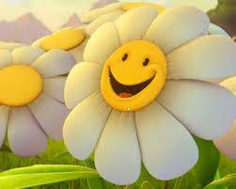
THANKS A LOT FOR BEING WITH US!
MADE BY OUR PROJECT STUDENTS

