Slide 1
Erasmus + KA 229 – School exchange partnership
CATCH – Climate And Treats To Cultural Heritage
2020-1-ES01-KA229-082560_2
OS `DESPOT STEFAN VISOKI` - DESPOTOVAC - SERBIA

Slide 2
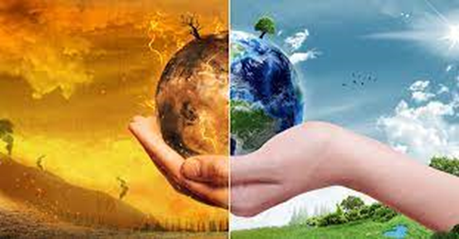
CULTURAL HERITAGE AREA AND REGION AND EFFECT OF THE CLIMATE CHANGE ON THEM OF DESPOTOVAC

Slide 3
THINK GLOBALLY, ACT LOCALLY,
LOVE AND PROTECT YOUR PLANET

Slide 4
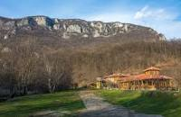
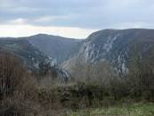
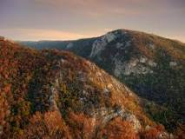
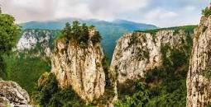
The center of Gornja Resava is Despotovac and it is located on the border of the slopes of Beljanica and Kučaj and the Despotovac basin. This region is rich in forests and minerals.

Slide 5
- The climatic characteristics of the Resava valley are closely related to its geographical location.
- The area around the Resava is intersected with numerous canyons and gorges, and because of this, there are different climate conditions.

Slide 6
- Resave's climate is basically moderate-continental, with moderately hot summers and moderately cold winters, which means that the seasons are clearly defined.

Slide 7
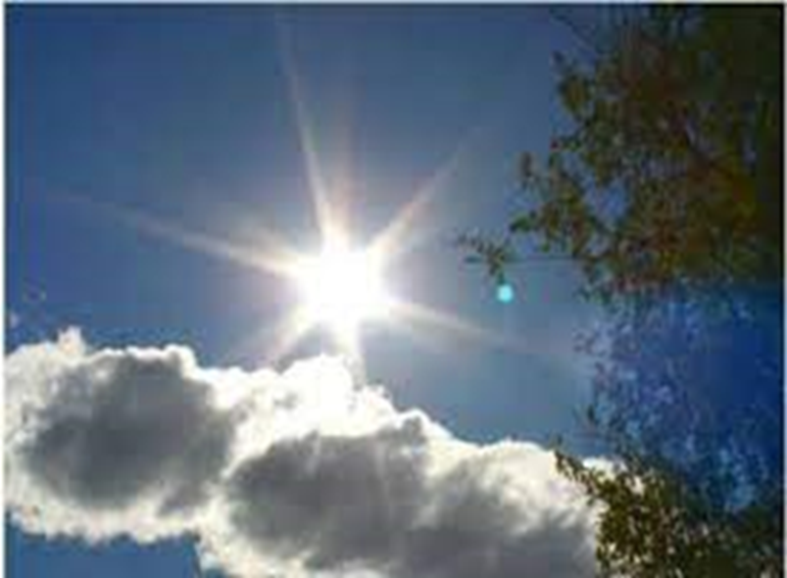
- In Serbia, as well as in Despotovac and its surroundings, the consequences of global climate change are being felt to a great extent.
- The increase in global temperature began in 1983 and is still ongoing. By the end of the century, the annual temperature will rise by 2.6 degrees.
- Due to warming, summers will be warmer by 3.5 and winters by 2.3 degrees C.
- We already need less energy for heating and more for air conditioning, while extreme heat becomes our reality.
Warmer winters can wreak the same havoc as warmer summers.

Slide 8
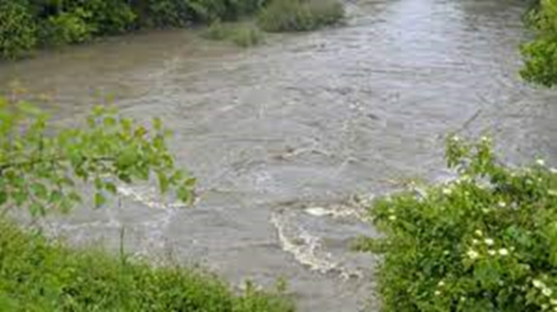
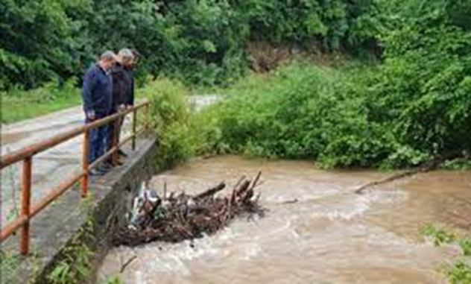
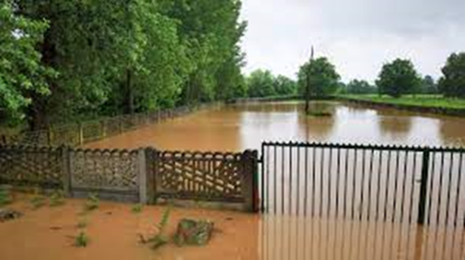
We have increasingly long summer droughts with shorter periods of extremely heavy rains, which cause floods and landslides.

Slide 9
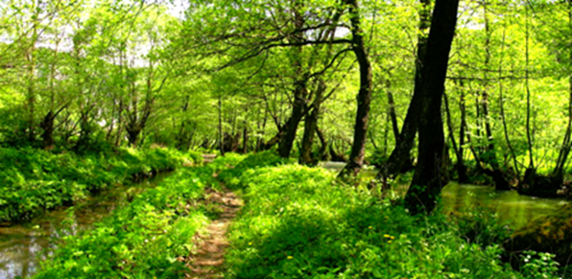
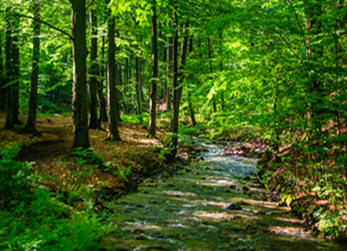
The effect of accelerated climate change also affects forests. In the region of Despotovac there is the Vinatovača rainforest. What is characteristic of this rainforest is
that not a single tree has been cut down here
and it also has not been taken away or moved.
Simply, when a tree falls under the influence of snow, wind or old age, it remains in the rainforest, untouched.

Slide 10
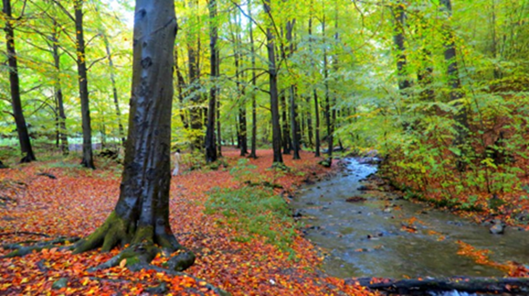
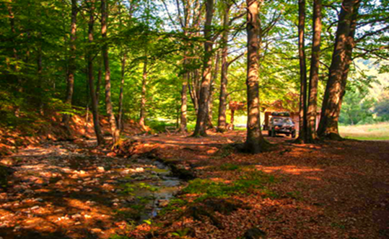
And that means: completely preserved nature, with NO human intervention. It is a strict nature reserve of the first category of state protection. The sign of protection of this natural treasure of Eastern Serbia is represented by hundred-year-old beech trees that have been growing here for more than 350 years. With an impressive height that reaches up to 45 meters and luxuriant green crowns, these trees give Vinatovača a special charm and beauty.

Slide 11
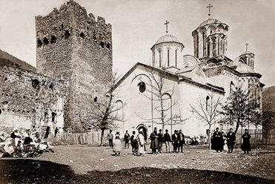
MANASIJA (OR RESAVA) MONASTERY
- For more than 600 years of its existence, the Manasija or Resava monastery has been demolished and desolated many times.
Climate change also damaged the walls and the monastery church.
Manasija from 1875

Slide 12
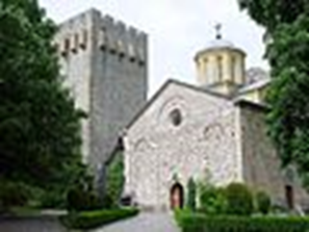
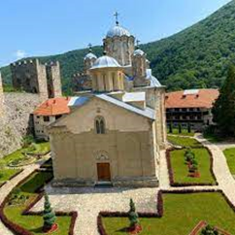
- A more extensive restoration was done in 1956, and the restoration continues today.
- Manasija is owned by the Republic of Serbia and has been declared a cultural monument of exceptional importance.

Slide 13
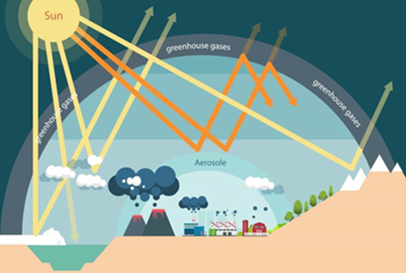
- Due to the burning of fossil fuels (coal, oil, gas), there is an increased content of greenhouse gases in the atmosphere.

Slide 14
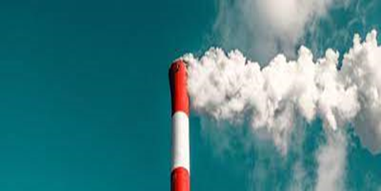
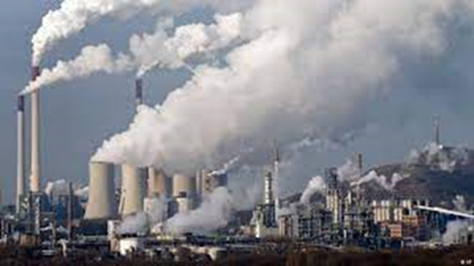
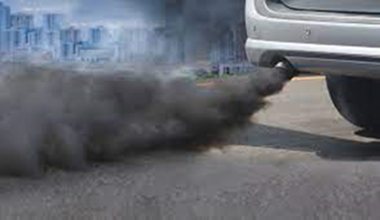
- CO2 or carbon dioxide is the primary gas, and there are also carbon monoxide, sulfur, ammonia and others. - Due to the impossibility of depositing energy and heat into the interplanetary space, there is an increase in the temperature on Earth and thus also the greenhouse effect. - The main cause of the negative greenhouse effect is the constant increase in carbon dioxide in the atmosphere.

Slide 15
What should be done?
Reduce the amount of dangerous gases in the atmosphere.

Slide 16
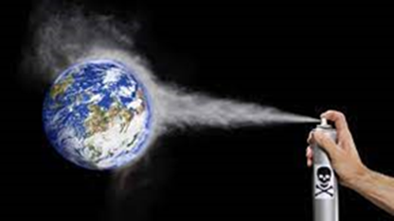
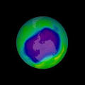
What destroys the ozone layer?
Chlorine, fluorine, bromine, carbon are used in cooling technologies or as spray gases used in the pharmaceutical and cosmetic industries.
These compounds break down ozone atoms, thinning the ozone layer and creating holes.

Slide 17
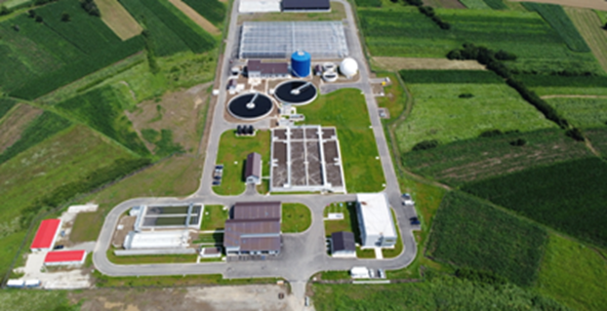
The degree of air pollution can be reduced by:
processing waste water

Slide 18
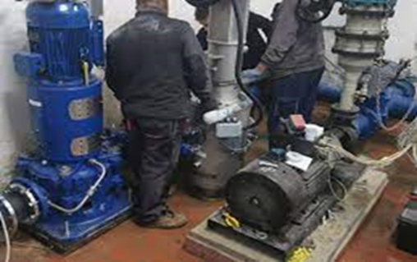
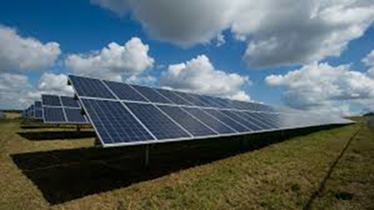
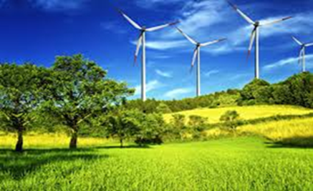
- installing filters
- and using renewable energy sources

Slide 19
THANK YOU FOR YOUR ATTENTION!
MADE BY OUR PROJECT STUDENTS

