Slide 1
The impact of climate change on the natural and cultural heritage of Gúta

Slide 2
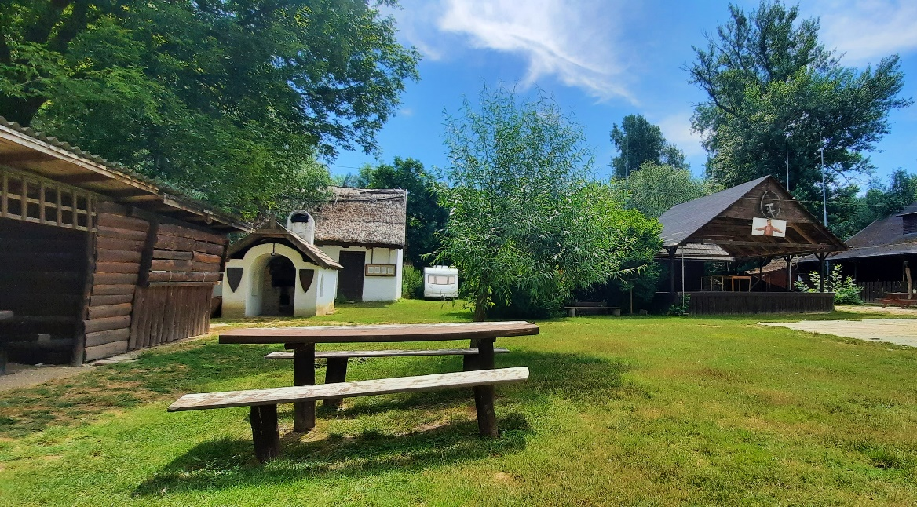
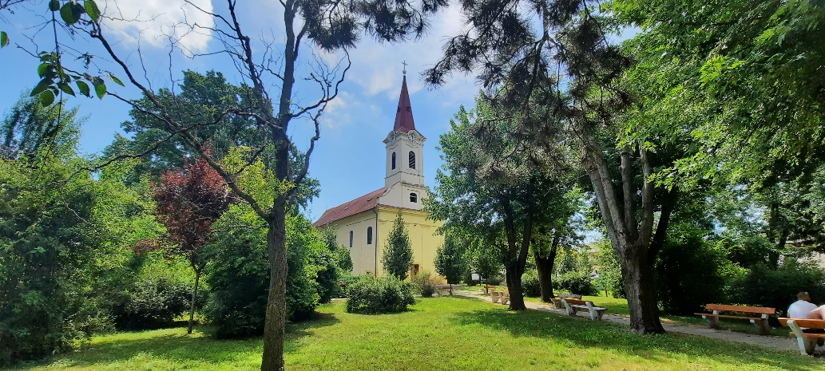
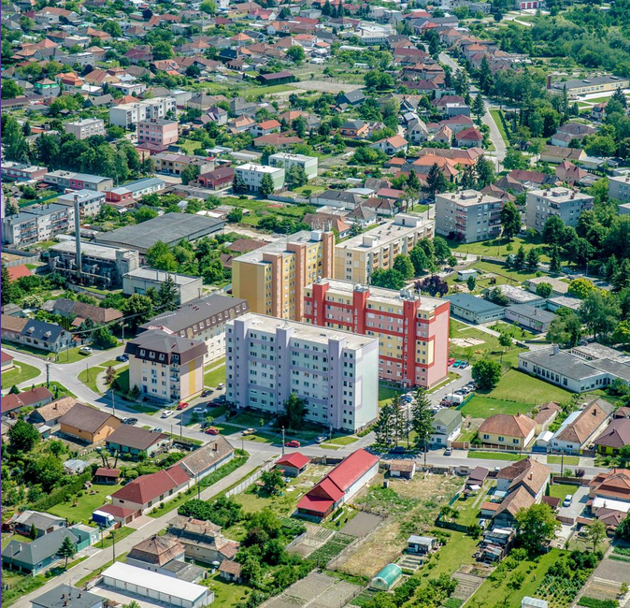
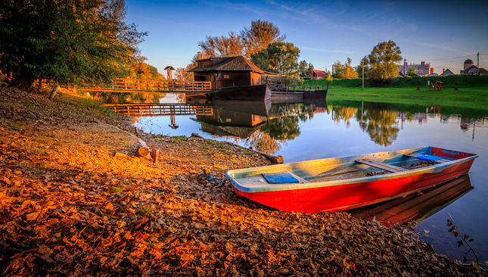
Our city Gúta

Slide 3
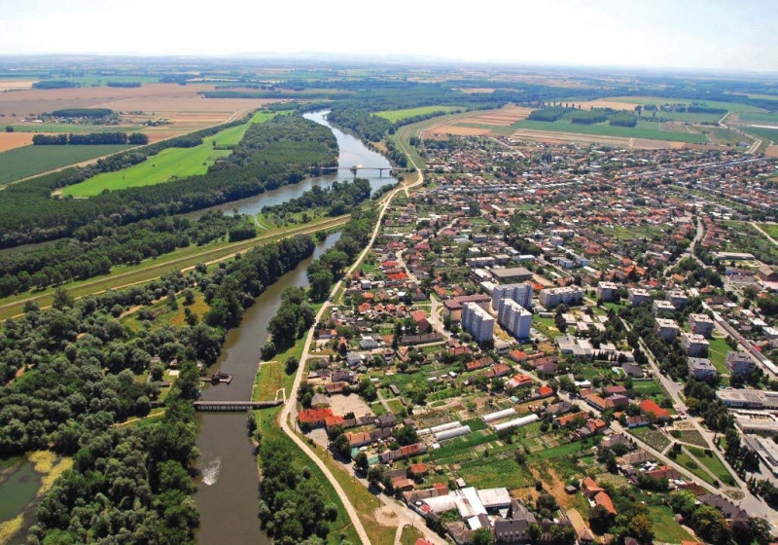
Gúta´s a town in southern Slovakia, 20 kilometers from the Hungarian border. Fun fact: the word Gúta comes from a Latin word ,,gutta´´, which means a drop of water. The city probably got its name from that word because it´s surrounded by rivers, for example, the Vágh river or the Small-Danubes backwater.

Slide 4
Our region Great Rye Island (Csallóköz)

Slide 5
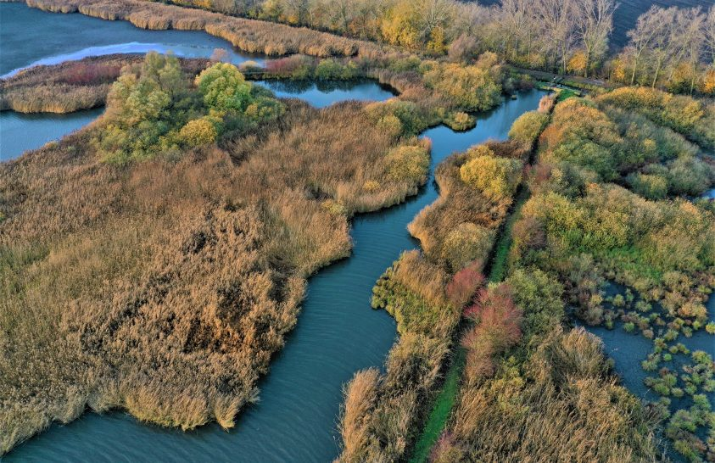
Gúta lay´s in the Great Rye Island , which is Europes biggest river island. This land is famous of its rare animals, especially birds. It belongs to Europe´s most protected places. In 1993 it was declared as a Ramsar territory.
Even the famous Captain Cousteau had visited it before.
Gúta´s cultural and natural heritage can be found here, for example the Dögös natural region.

Slide 6
The impact of climate change on Gúta´s natural heritage

Slide 7
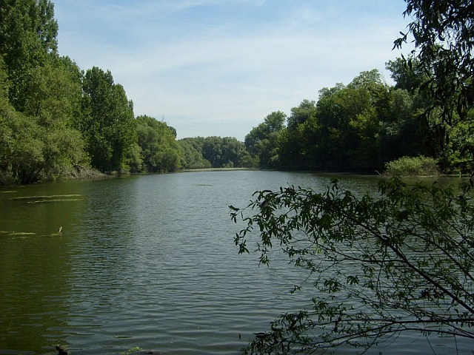
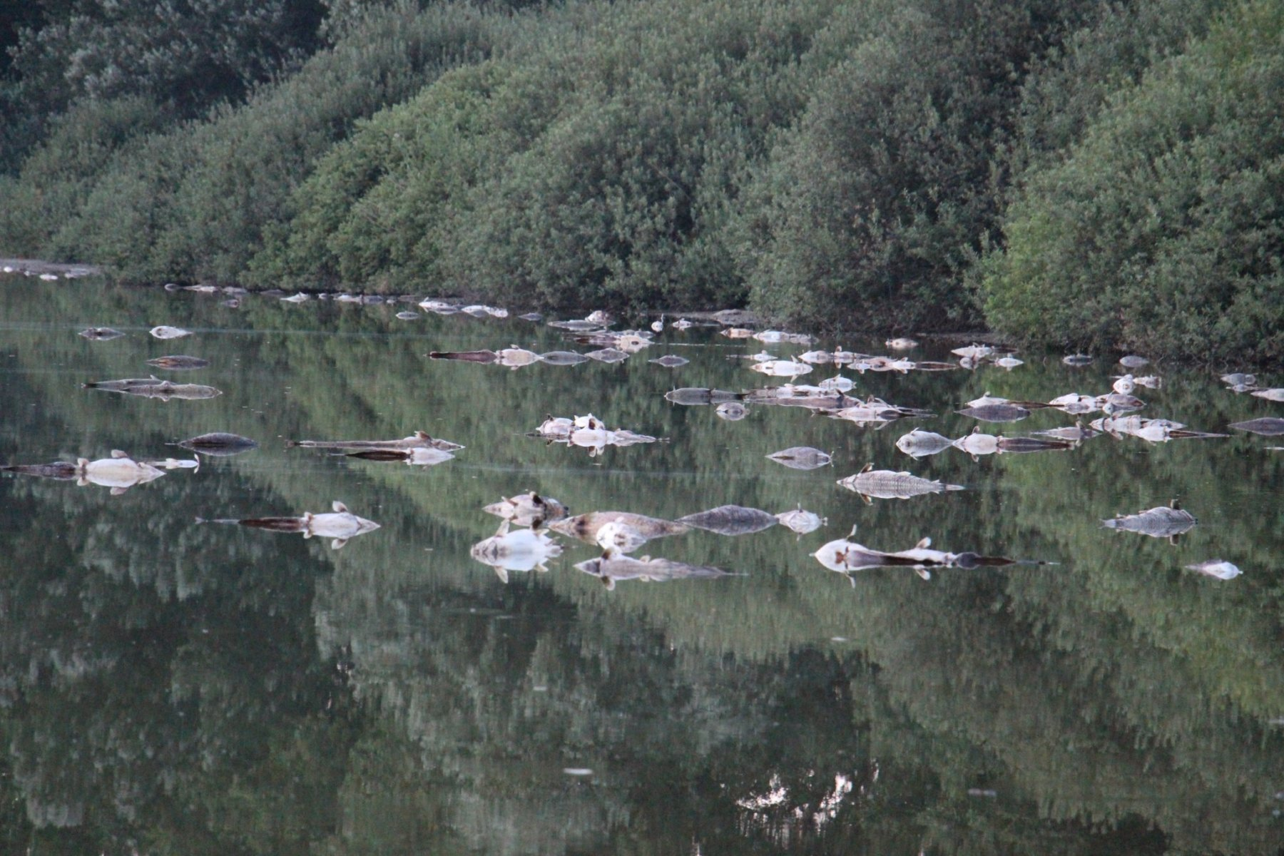
On the Small-Danubes backwater, the Dögös region, ships could travel in the 19th century.
In the 20th century, people didn´t pay much attention to the backwater´s purity, and the water situation became so bad that ships couldn´t even travel on it.
In the last century, this place gave shelter to many rare plants and animals. Nowadays, lots of fish have drowned or died out.

Slide 8
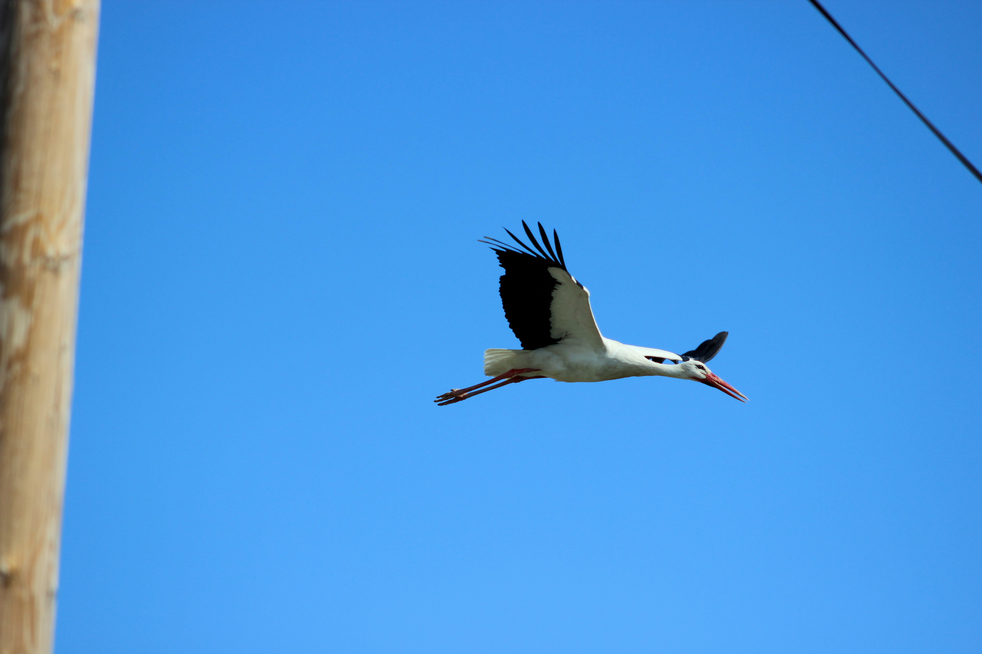
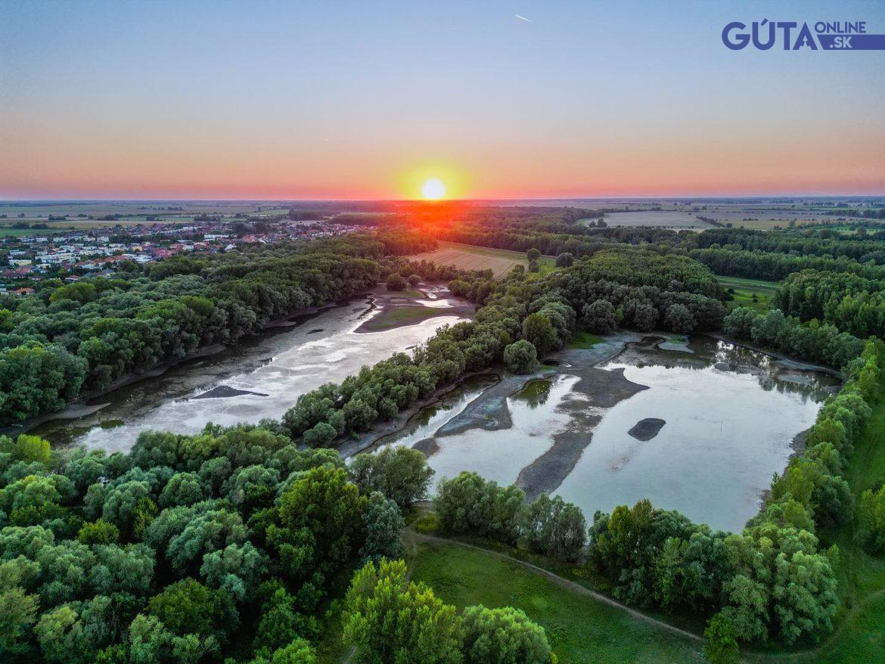
Even birds don´t behave the same way that they used to. For example, storks in winter don´t go to Africa but instead they stay here.
Swallows disappearance caused a
so-called fly „invasion“.
In this drone footage, we can see how bad the Dögös region looks.
Many organizations /volunteers do environmental protection every day, where they try to clean the region. Our students also help with the cleaning to save the birds of the Dögös region.

Slide 9
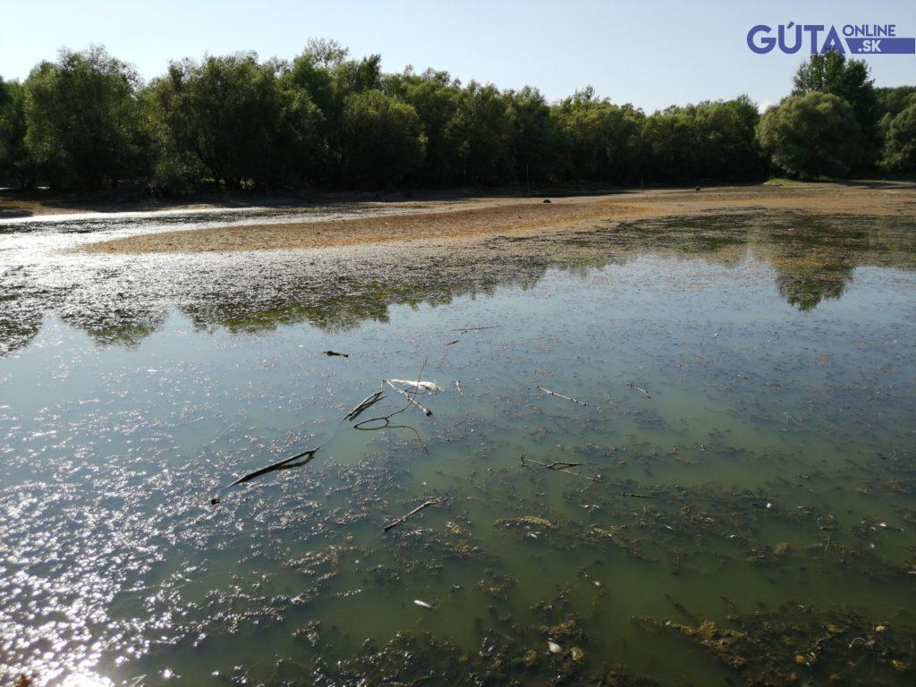
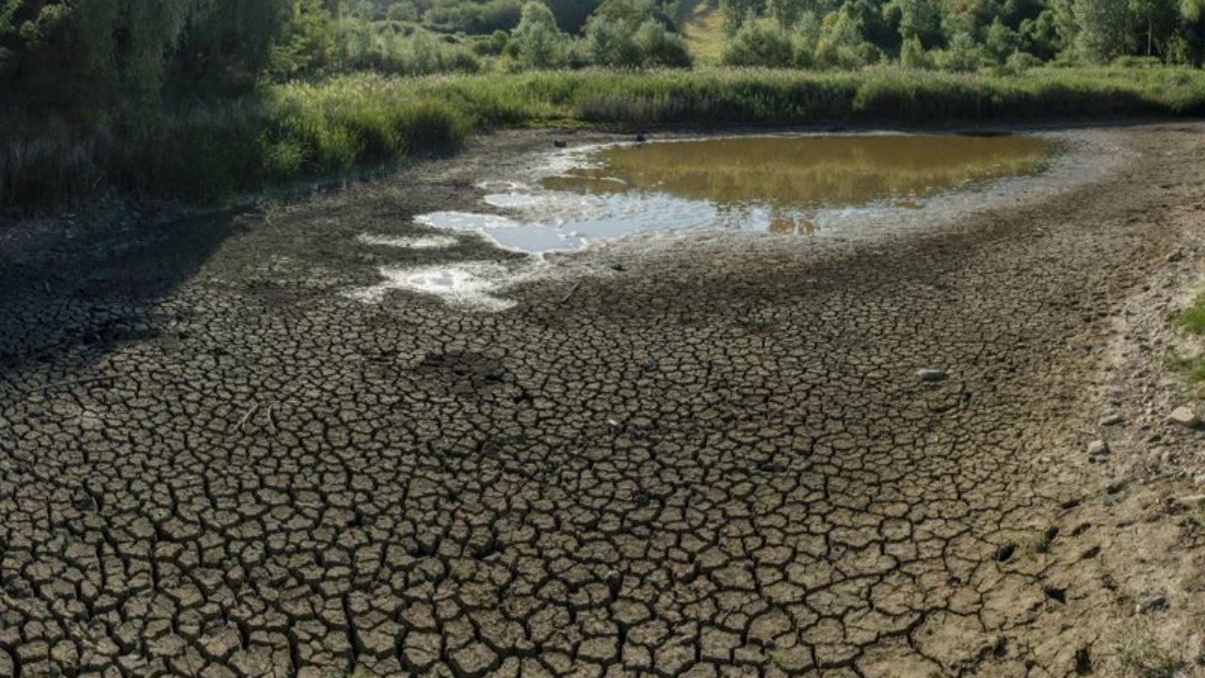
Due to increasingly extreme weather conditions, the Dögös lake, located on our city's outskirts, began to shrink and almost dried out last summer.

Slide 11
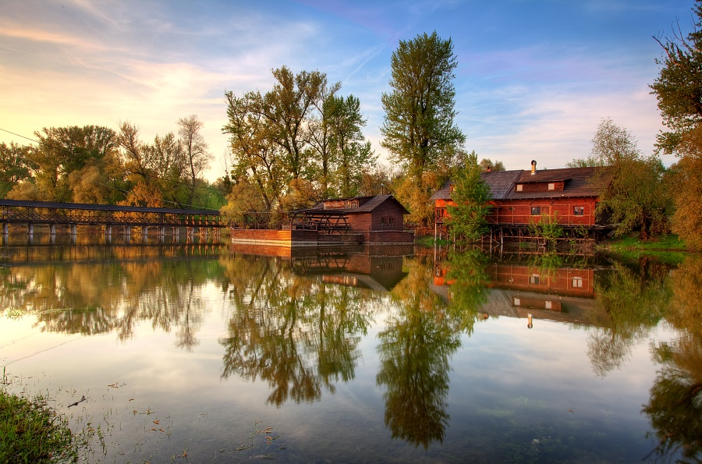
The water mill

Slide 12
The most beautiful attraction of our city is the water mill. It is situated in the DÖGÖS nature reserve. The mill is accessed by the longest completely wooden covered bridge in Europe.

Slide 13
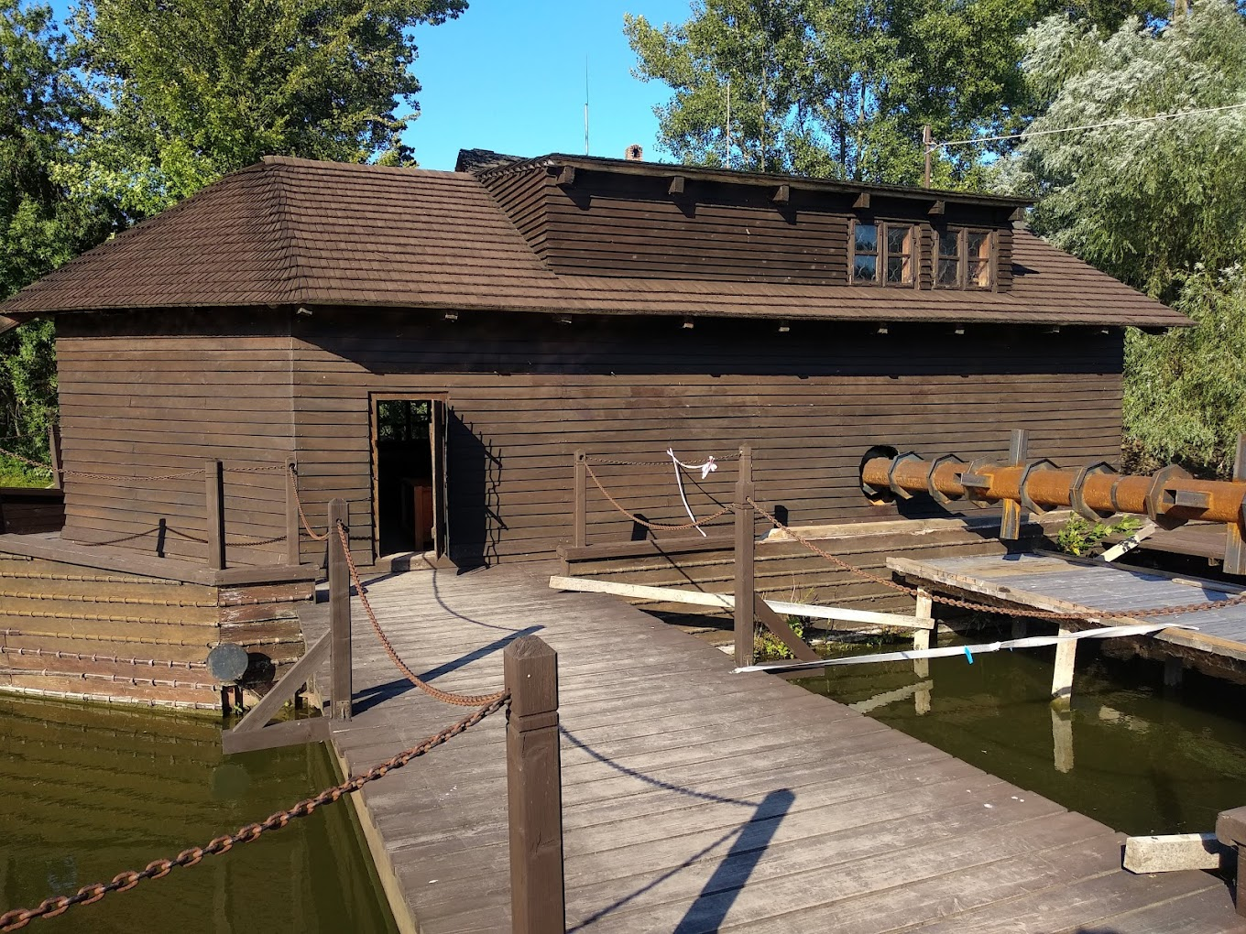
.In the area of the mill there is a folklore open - air museum. Directly at the mill, a water milling museum was established which features exhibits including a unique machine for production of fishing nets one, of the first in the world. The boat mill is also among Slovakia’s national cultural heritage sites.

Slide 14
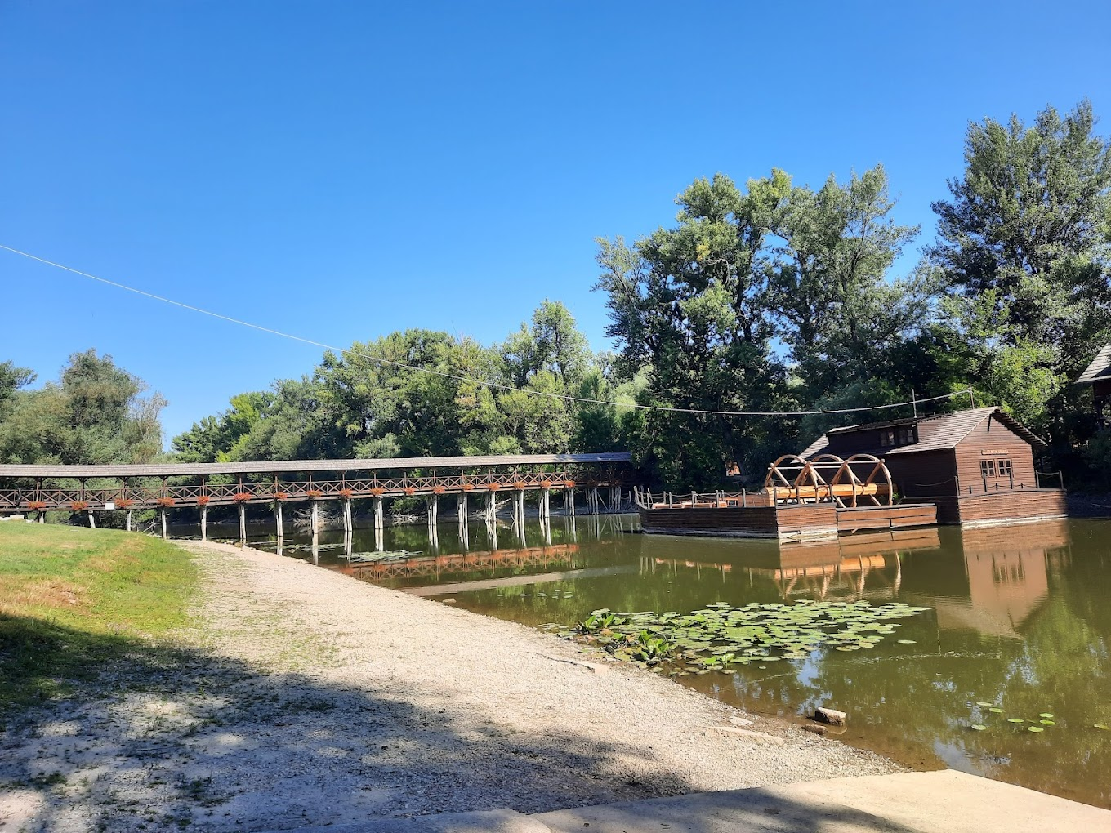
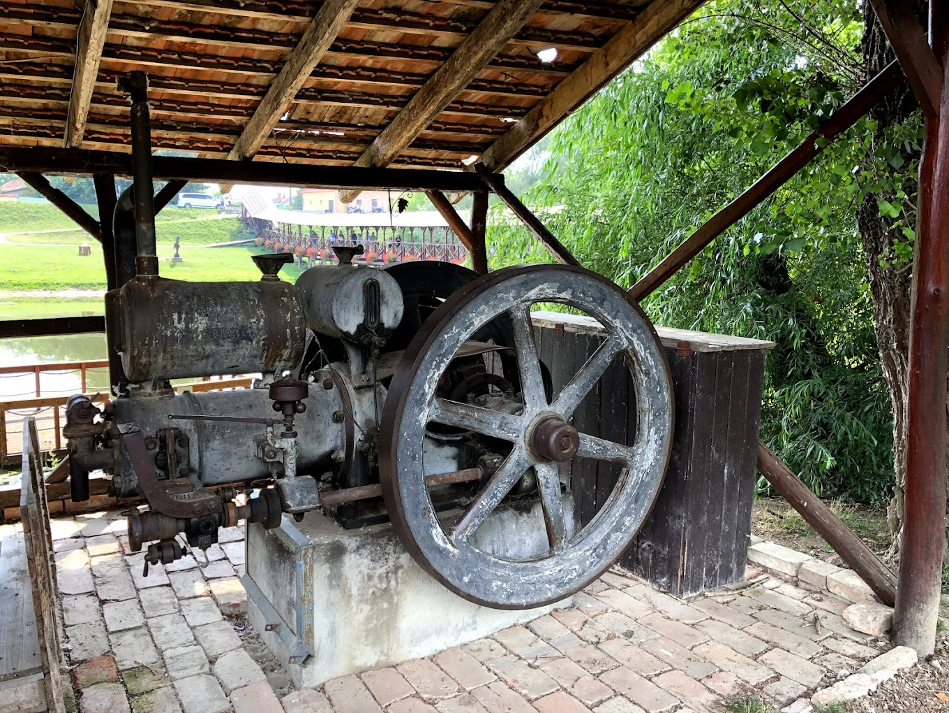
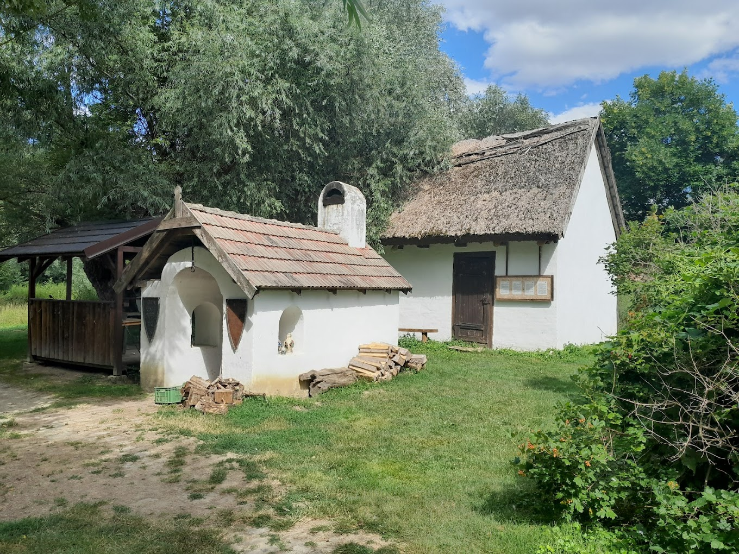

Slide 15
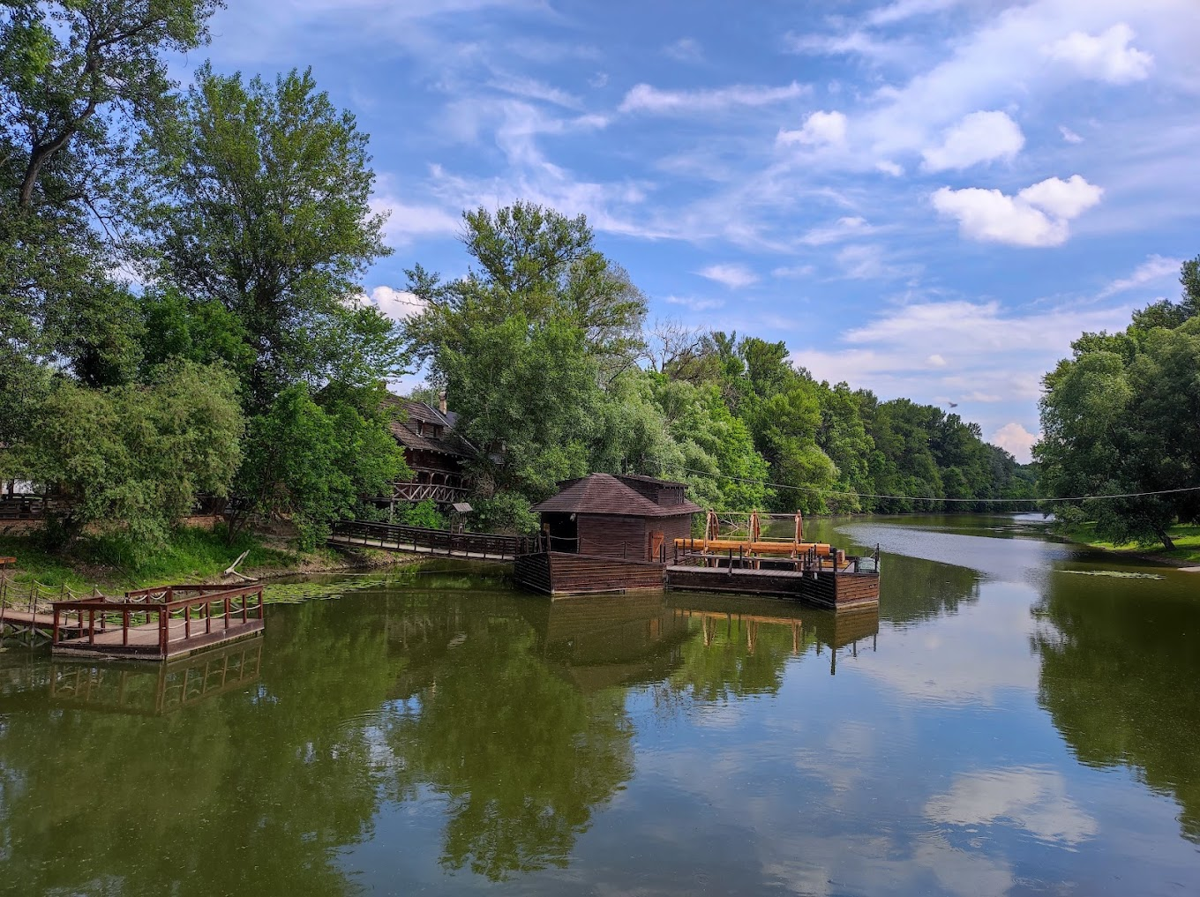
The original mill was built in 1920 which was standing on a two parallel swimming, anchored boat. It was running until 1945, but it burned down under mysterious circumstances.

Slide 16
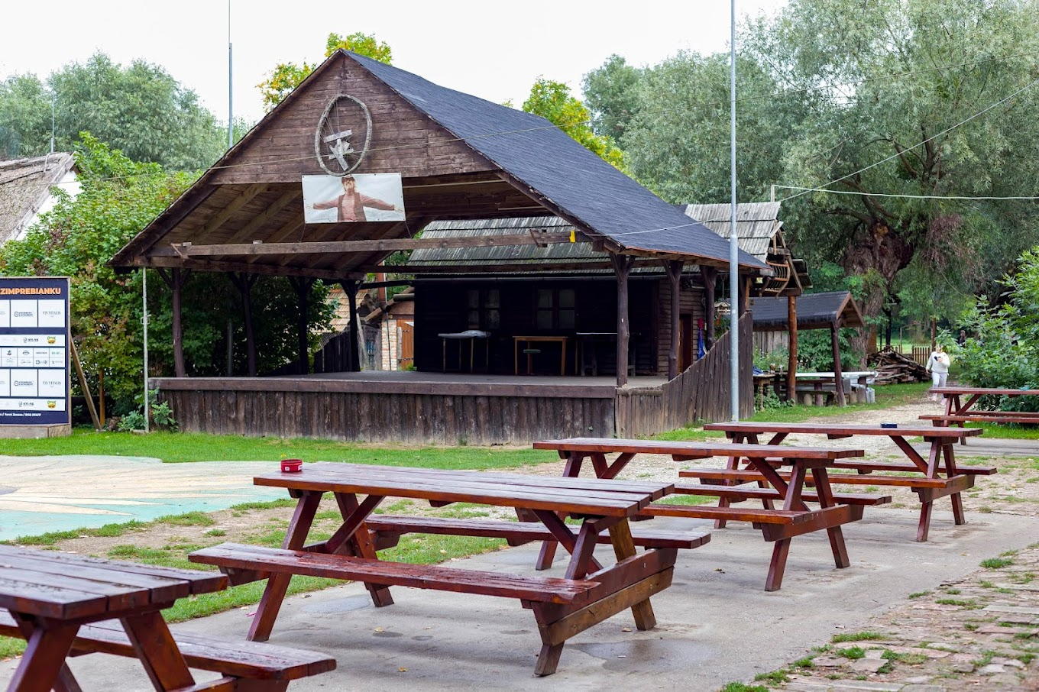

Slide 17
The water mill association also arranges environmental programs for the student groups. The main mission for this association is to teach today's generation about organic education/ecology.
Beside lots of others, children can have the opportunity to know how our ancestors could use so many natural energies without polluting the nature. Ongoing climate change, affects each of us. Therefore, it is crucial to be able to identify problems and implement the right adaption and mitigation measures.

Slide 18
Thank you for your attention!

